Slide 1
CHRONIC PANCREATITIS
CYSTS AND FISTULAS OF THE PANCREAS

Slide 2
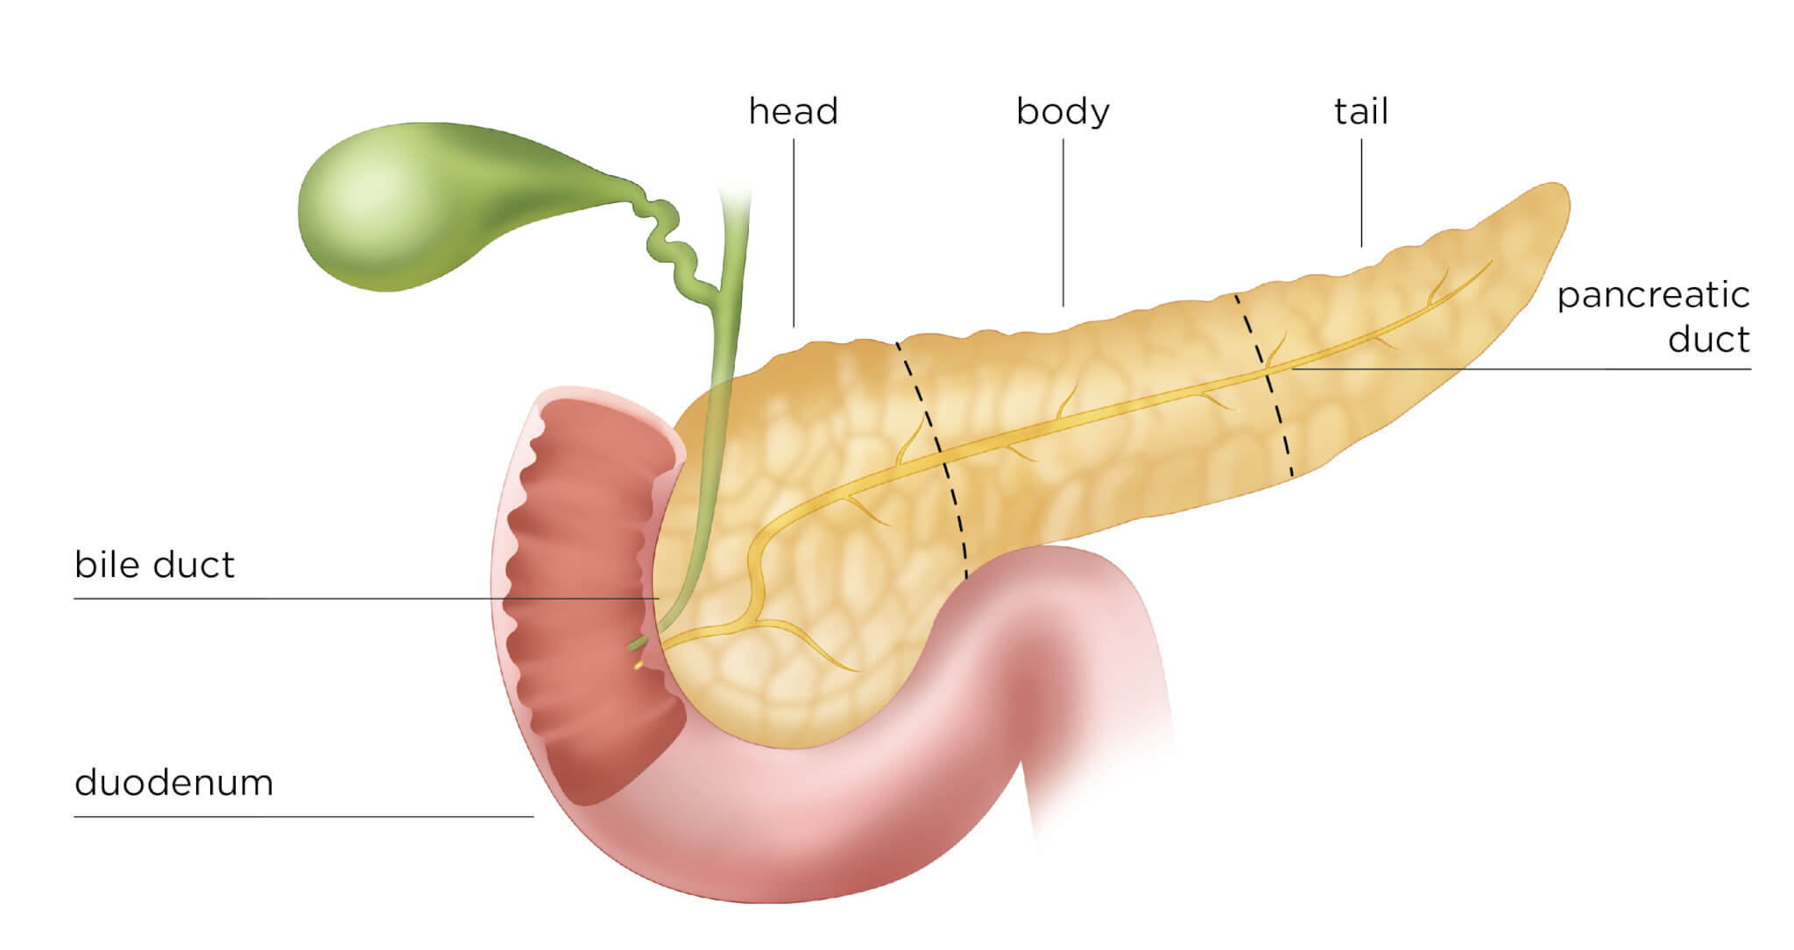
PANCREAS ANATOMY

Slide 3
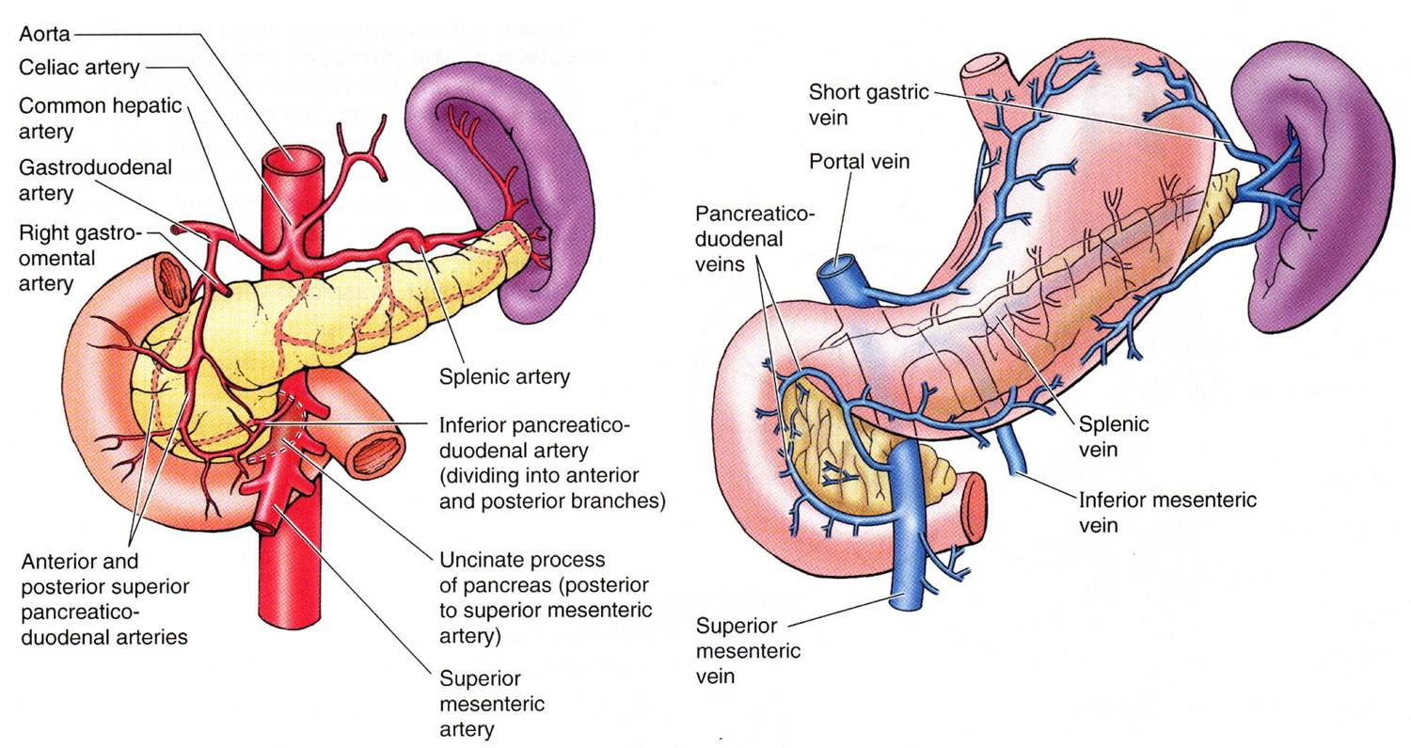
PANCREAS ANATOMY

Slide 4
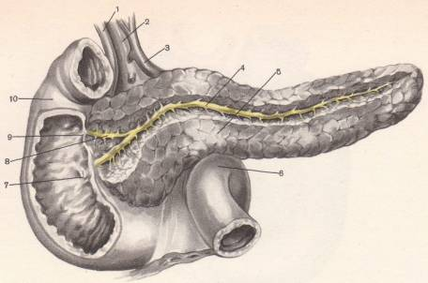
PANCREATIC DUCTS
1 - ductus holedoсhus; 2 - v. portae; 3 - a. hepatica communis; 4 - ductus pancгeaticus; 5 - pancreas; 6 - flexura duodenojejunalis; 7 - papilla duodeni majoг; 8 - ductus pancreaticus accessoгius; 9 - papilla duodeni minor; 10 - duodenum.

Slide 5
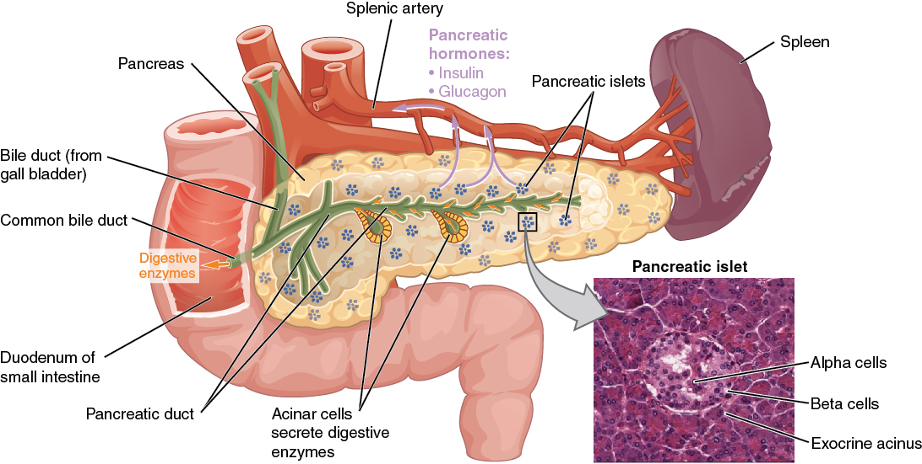
PANCREAS ANATOMY

Slide 6
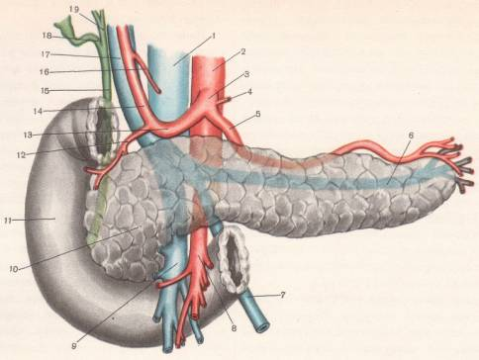
Pancreatic blood supply
1 - v. cava infeгior; 2 - aorta abdominalis; 3 - tгuncus ooeliacus; 4 - a. gastгica sinistra; 5 - a. lienalis; 6 - v. lienalis; 7 - v. mesenterica inferioг; 8 - a. mesenterica supeгioг; 9 - v. mesenteгica superior; 10 - caput pancreatis; 11 - duoderшm; 12 - a. gastroduode-nalis; 13 - a. hepatica communis; 14 - a. hepatica propria; 15 - ductus choledochus; 16 - a. gastгioa dextra; 17 -- v. portae; 18 - ductus cysticus; 19 - ductus hepatious commшus.

Slide 7
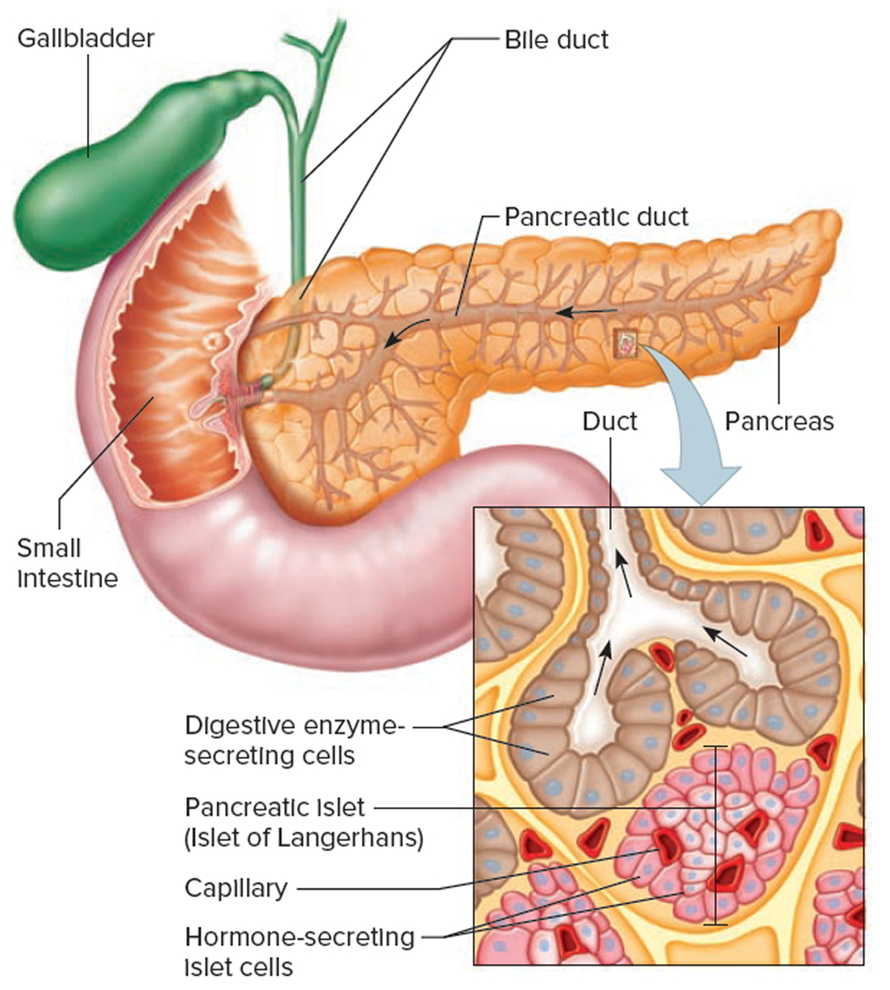
PANCREAS ANATOMY

Slide 8
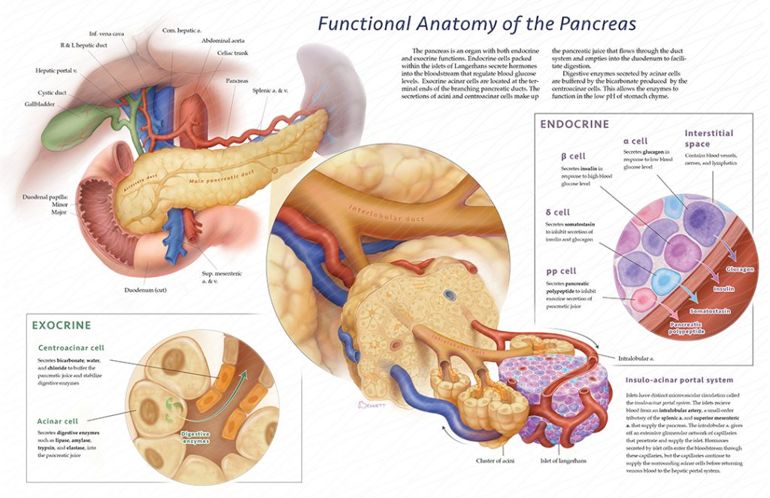

Slide 9
CHRONIC PANCREATITIS
The term chronic pancreatitis refers to a group chronic pancreatic diseases various etiologies, mainly inflammatory nature, with phase-progressive focal, segmental or diffuse degenerative, destructive changes in its exocrine part, atrophy of glandular elements (pancreatocytes) and replacing them with connective (fibrous) tissue; changes in the duct system of the pancreas with the formation of cysts and calculi, with varying degrees of violation exocrine and endocrine functions.

Slide 10
Causes of the increase in incidence:
Change in diet
Alcoholism
An increase in the number of patients with cholelithiasis
Diagnostic Improvement
Hess (1962) - chronic pancreatitis - pancreatopathy after acute pancreatitis.

Slide 11
ETIOLOGY
1. Gallstone disease (30-40%), incl. pathology of the terminal biliary tract (choledocholithiasis, odditis, cholangitis, stricture of the large duodenal papilla)
2. Alcoholism (30-75%). Mechanism:
a. Alcoholic stimulation of exocrine pancreatic activity.
b. Violation of the evacuation of pancreatic secretion due to the reflex spasm of the sphincter of Oddi in response to irritation of the duodenal mucosa (morphine-like effect).
3. Gastrointestinal diseases (gastric and duodenal ulcers with penetration, chronic lipoproteins, gastroduodenitis)
4. Injury of the pancreas: penetrating wounds, closed injuries, intraoperative injuries.
5. Blood supply disturbance - chronic arteriomesenteric insufficiency (atherosclerotic lesion of the pancreatic vessels).

Slide 12
PATHOLOGICAL ANATOMY
Overgrowth of connective tissue (fibrosis, sclerosis)
Atrophy of the pancreas
The development of sites of peri- and intralobular fibrosis
Compaction of the gland, its increase in volume
Inflammatory Infiltration and lipomatosis
The formation of retention cysts
Calcification (Wirsungolithiasis)

Slide 13
CLASSIFICATION
I. By etiology:
A. Primary pancreatitis (the development of the inflammatory process from the very beginning primarily in the pancreas):
  1. alcohol
  2. alimentary
  3. infectious
  4. vascular
  5. medicinal
  6. exchange
  7. mixed etiology.
B. Secondary pancreatitis (concomitant), development against the background of diseases of the digestive system:
  1. cholangiogenic
  2. lymphogenous
  3. gastrointestinal tract diseases (KNDP, duodenal diverticulum, peptic ulcer)
  4. endocrinopathies
C. Post-traumatic pancreatitis
  1. open injury
  2. blunt injury

Slide 14
II. According to morphological characteristics:
1. sclerosing
2. parenchymal
3. complicated:
a. tissue and duct calcification
b. duct obstruction
c. suppuration
d. cyst formation
e. compression of portal veins (segmental port.hypertension)
f. compression of the biliary tract
g. duodenal compression
h. colon compression

Slide 15
III. According to the features of the clinic:
chronic recurrent pancreatitis,
Chronic pain pancreatitis,
chronic painless (latent),
chronic pseudotumorous,
chronic cholecystopancreatitis,
chronic pseudocystic (pancreatitis with outcome in the cyst),
chronic calculous pancreatitis (wirsungolithiasis);

Slide 16
IV phase of the course:
1. remission
2. exacerbation.
V. The course of the disease:
1st stage - mild;
2nd stage - moderate course;
3rd stage - severe (terminal, cachectic stage).
VI. Exacerbation frequency:
1. 1 - 2 times a year (32%);
2. 3-4 times a year (25%);
3. Frequent exacerbations, diabetes mellitus (33%).

Slide 17
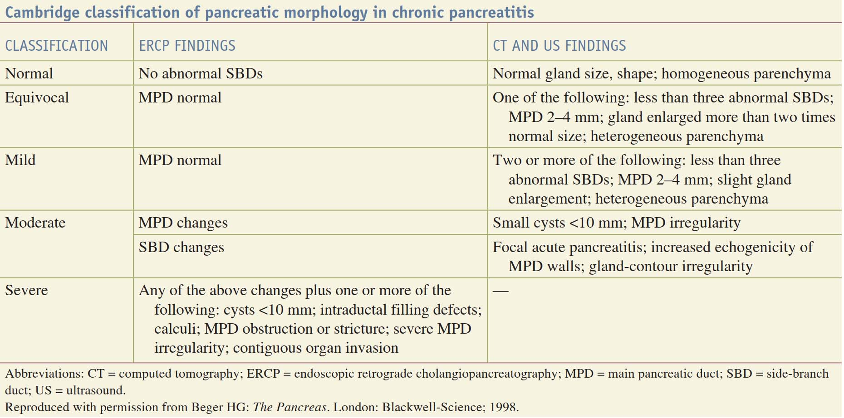

Slide 18

Clinic
4 main syndromes:
Pain syndrome;
Pancreatic exocrine insufficiency syndrome;
The syndrome of incretory insufficiency.
Cholestasis Syndrome (obstructive jaundice).

Slide 19
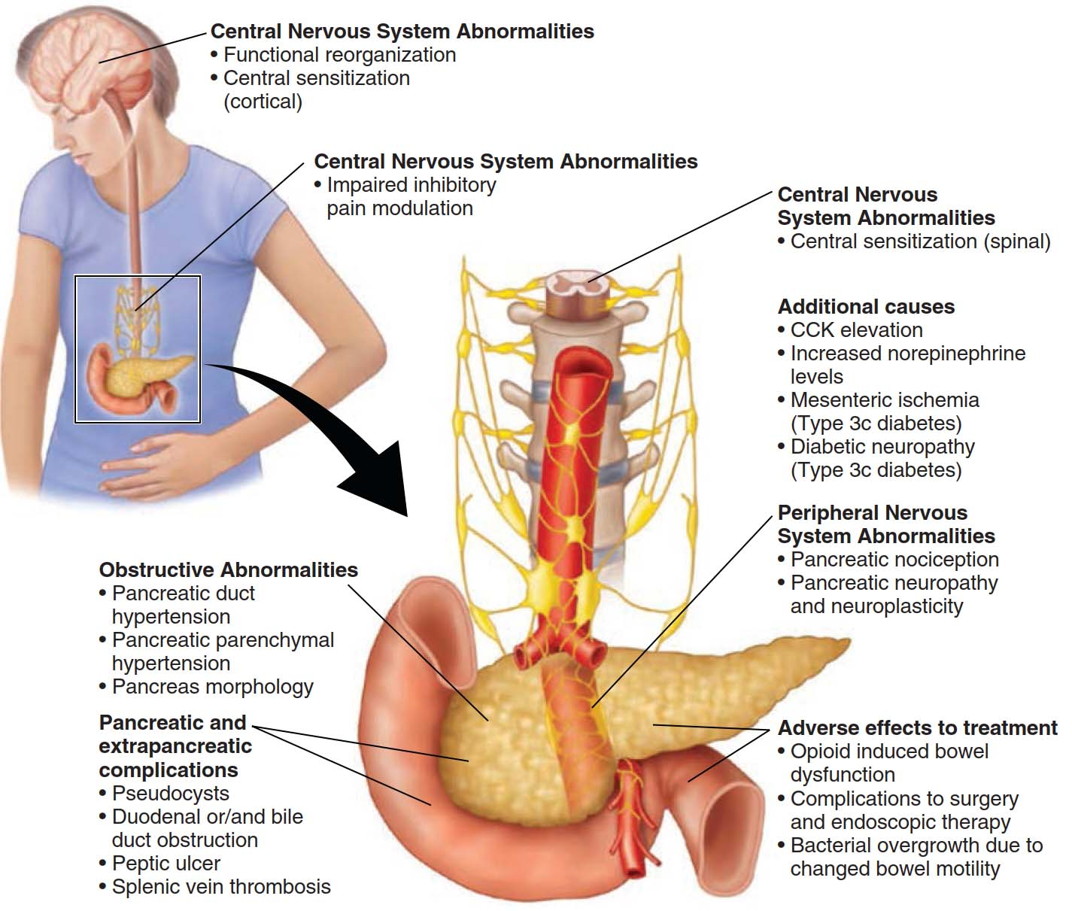
Pain mechanisms in chronic pancreatitis.

Slide 20
Chronic recurrent pancreatitis, which is characterized by pain crises, outside of which the patient's condition remains relatively safe (the most common form of the disease). With exacerbation, the clinic proceeds as acute pancreatitis.
Chronic pain pancreatitis, proceeding with a constant pain syndrome.
Chronic latent (painless) pancreatitis, in which violations of the external and internal secretion of the pancreas come to the fore.
Pseudotumorous (obstructive) chronic pancreatitis with a primary lesion of the pancreatic head, which often leads to the development of cholestasis and obstructive jaundice.

Slide 21
LABORATORY DIAGNOSTICS:
General blood test, biochemical study
Study of exocrine function (secretin-pancreosimine test, Lund test - after standard breakfast, aspiration of duodenum contents, bentaramine test, morphine-proserin test - determination of amylase, lipase, urine diastase)
The study of intra-secretory function (Staub-Traugott test, glycemic profile)
Coprological research - Schmidt's diet (polypecal, steatorrhea, creatorrhea, amylorrhea)

Slide 22
LABORATORY TESTS:
secretin-pancreosimine (cerulein), which consists in stimulating the exocrine function of the pancreas by sequential parenteral administration of secretin, and after 30 minutes cholecystokinin, determining the amount of secretion in all 6 portions of the duodenal contents obtained, the concentration of bicarbonates in the first 3 and the enzyme -t - in the last 3 servings;
PABA test (bentiramine): assessment of the load results of 0.5 g of para-aminobenzoic acid tripeptide (bentiramine). The test is positive when less than 50% of the drug is excreted in a 6-hour portion of urine;

Slide 23
LABORATORY TESTS:
Lund test: load with food mixture (15 g of olive oil, 15 g of milk powder, 45 g of glucose, 15 ml of fruit syrup, up to 300 ml of distilled water). Its results are interpreted in the same way as in the secretin-pancreosimine test;
morphine-proserin test: stimulation of the pancreas by intramuscular injection of 1 ml of 1% morphine solution and 1 ml of 0.05% proserin solution with determination of amylase activity in blood and urine.
A more accurate method for assessing the exocrine function of the gland at present is an oral test with 13C-triglycerides, the degree of cleavage of which in the digestive tract is judged by the level of 13CO2 in exhaled air.

Slide 24
LABORATORY TESTS:
Pancreatic endocrine function is more often assessed using the Staub-Traugott double sugar load (fasting patient takes 50 g of glucose and the same amount after 1 h). Patients with chronic pancreatitis find an increase in the concentration of glucose in the blood (the graph shows a bumpy curve with a gentle slope), which is associated with a defeat of the insular apparatus.
The results of a coprological study indicate the presence of polypecal (over 400 g per day), creatorrhea (an increased content of undigested muscle fibers in the feces), steatorrhea (more than 9% when the daily diet contains 100 g of fat), amylorrhea (the presence of a large amount of feces starch).

Slide 25
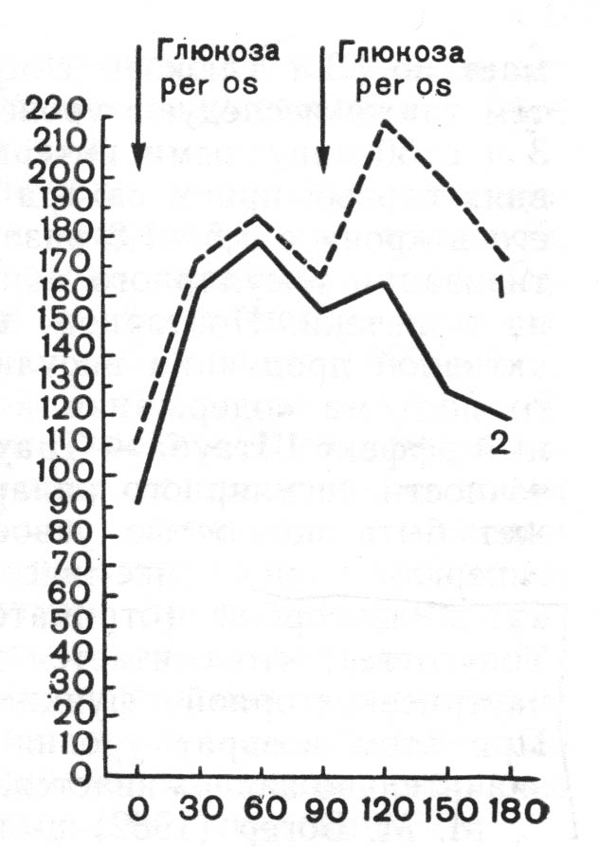
Variants of the glycemic curve according to the Staub-Traugott.
1 - negative effect;
2 - a positive effect.

Slide 26
INSTRUMENTAL DIAGNOSTICS
Ultrasound
Contrast radiography of the stomach, duodenum;
ERCP;
CT, MRI;
Angiography;
Laparoscopy, including pancreatoscopy
Puncture biopsy (under ultrasound)

Slide 27
When ultrasound of the pancreas is assessed:
1. the size of the body,
2. its contours,
3. structure,
4. tissue density,
5. presence of calcification,
6. presence of virsungolithiasis,
7. presence of focal formations

Slide 28
Normally, the pancreas has a homogeneous fine-grained internal echo structure.
Normal sizes: head 25-30 mm, body <18 mm, tail 25-30 mm, duct 2-3 mm.

Slide 29
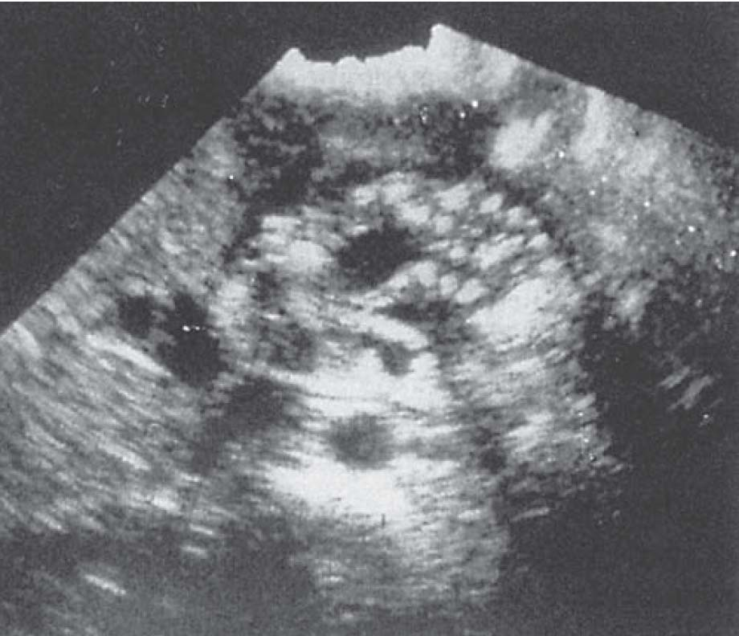
Sonography in chronic pancreatitis. Transabdominal sonogram of patient with chronic pancreatitis demonstrates heterogeneity of the pancreatic parenchyma, dilated ductal systems, and cyst formation.

Slide 30
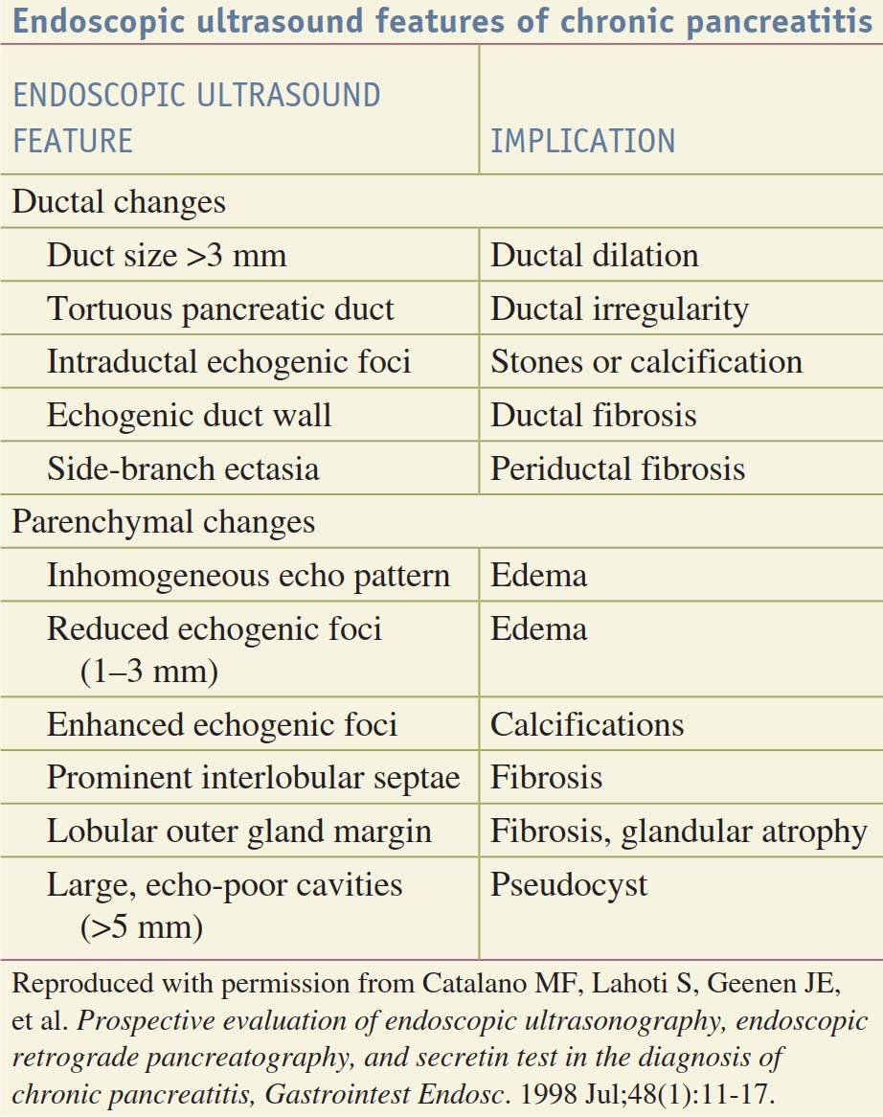

Slide 31
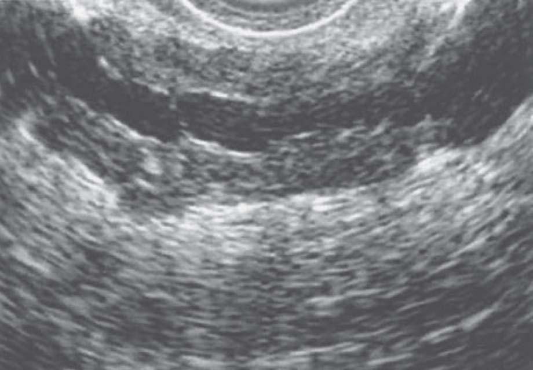
Endoscopic ultrasound of chronic pancreatitis. The endoscopic ultrasound appearance of the parenchyma is heterogeneous, and dilated ducts are seen, indicating early obstructive pancreatopathy.

Slide 32
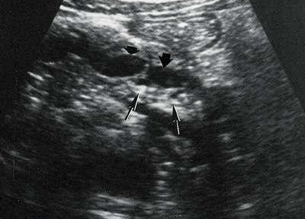
Much attention is paid to the imaging of the pancreatic duct (N- 2-3 mm), because by its diameter, one can judge the presence or absence of ductal hypertension
Thin arrows indicate calcifications, and thick arrows indicate an enlarged and segmented pancreatic duct.

Slide 33
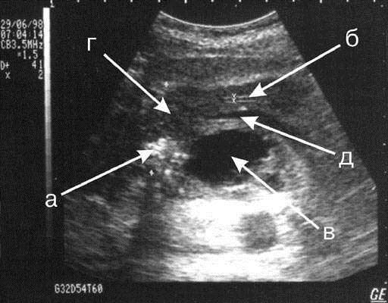
An echogram of chronic pancreatitis with a primary lesion of the pancreatic head: a) calcifications in the head of the pancreas; б) the unexpanded Virsungianov duct; в) pancreatic pseudocyst; г) enlarged pancreatic head; д) splenic vein

Slide 34
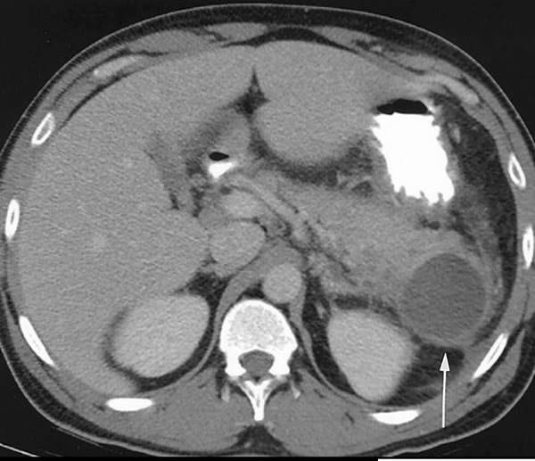
CT. Postnecrotic Pseudocyst

Slide 35
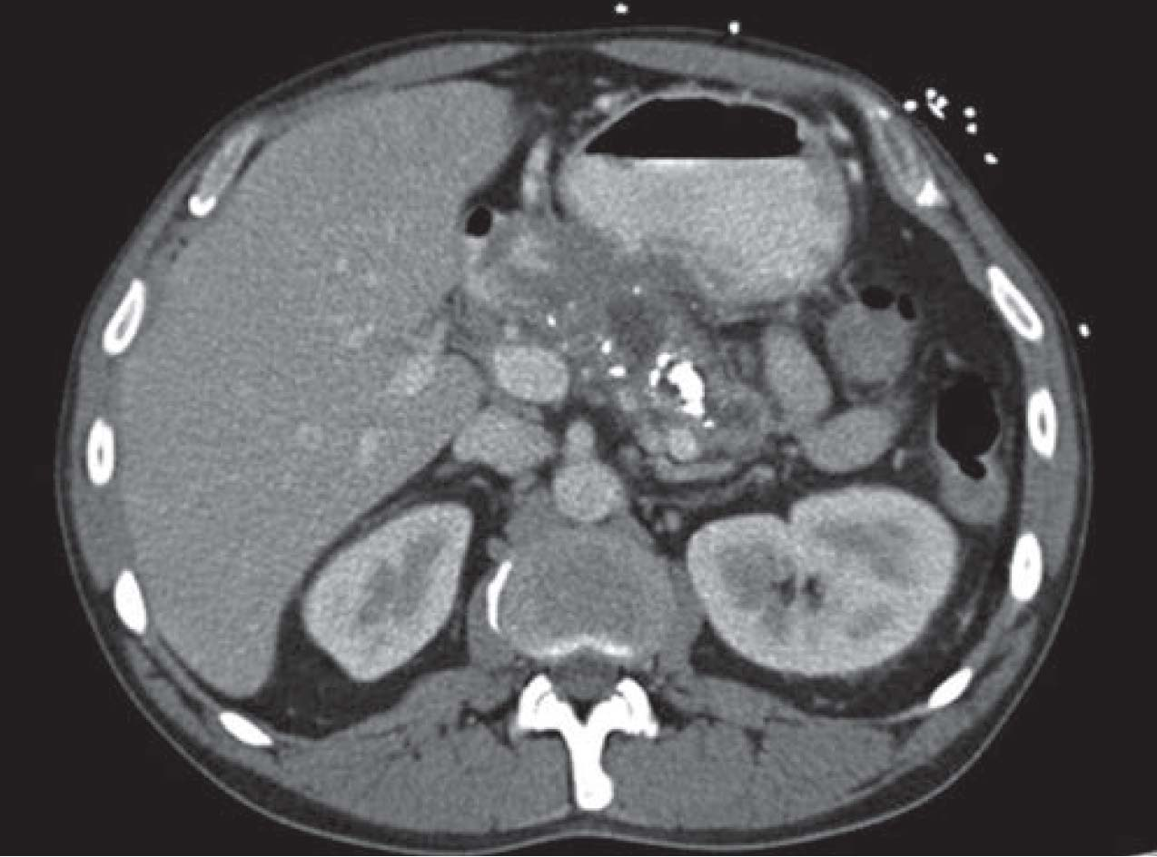
Computed tomographic imaging of chronic pancreatitis. A dilated pancreatic duct is seen, with evidence of intraductal stones and parenchymal calcification.

Slide 36
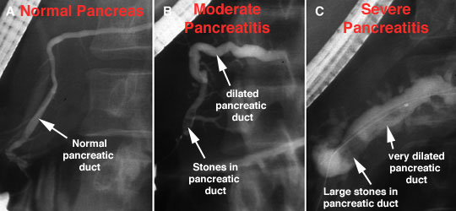
ЭРХПГ

Slide 37
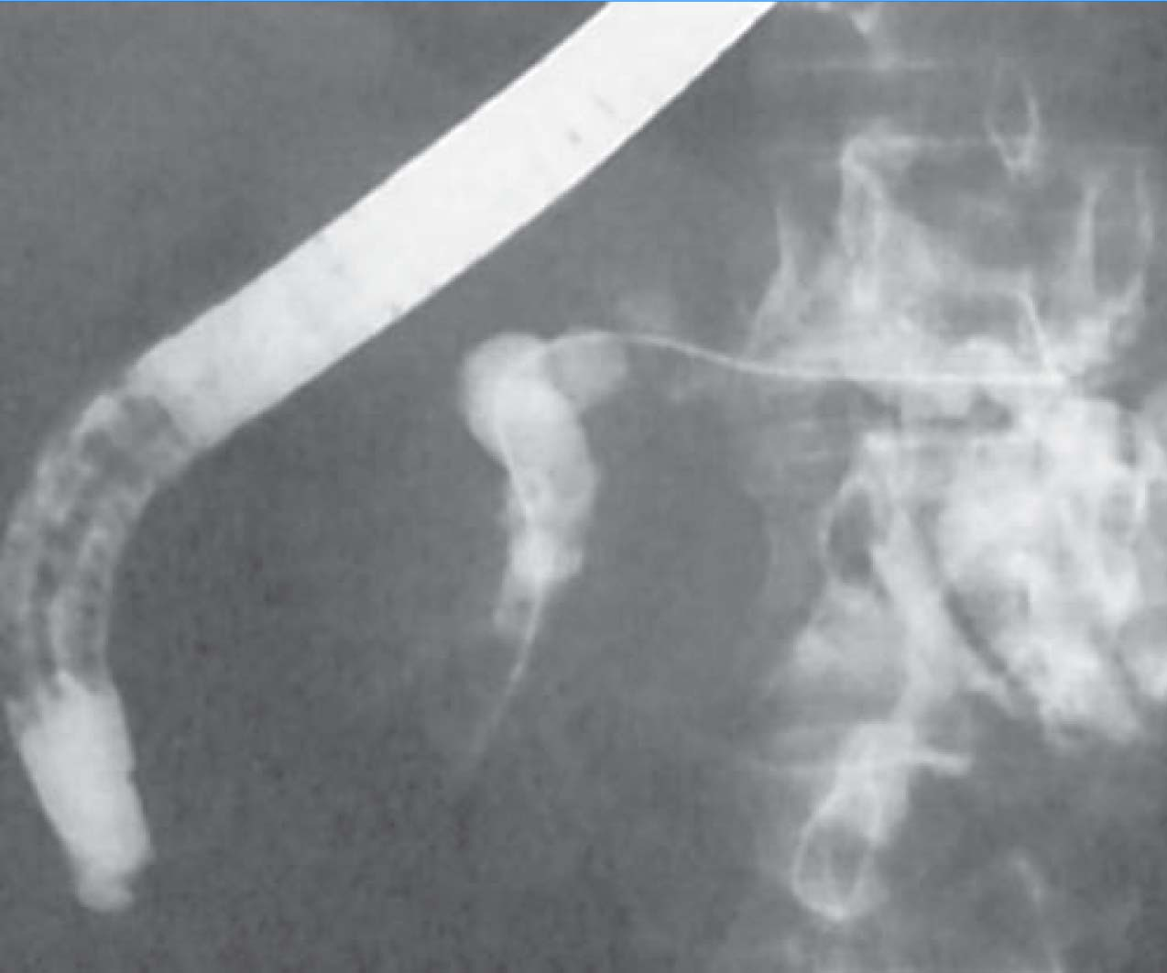
Pancreatic duct stenting. At endoscopic retrograde cholangiopancreatography, a stent is placed in the proximal pancreatic duct to relieve obstruction and reduce symptoms of pain. Pancreatic duct stents are left in place for only a limited time to
avoid further inflammation.

Slide 38
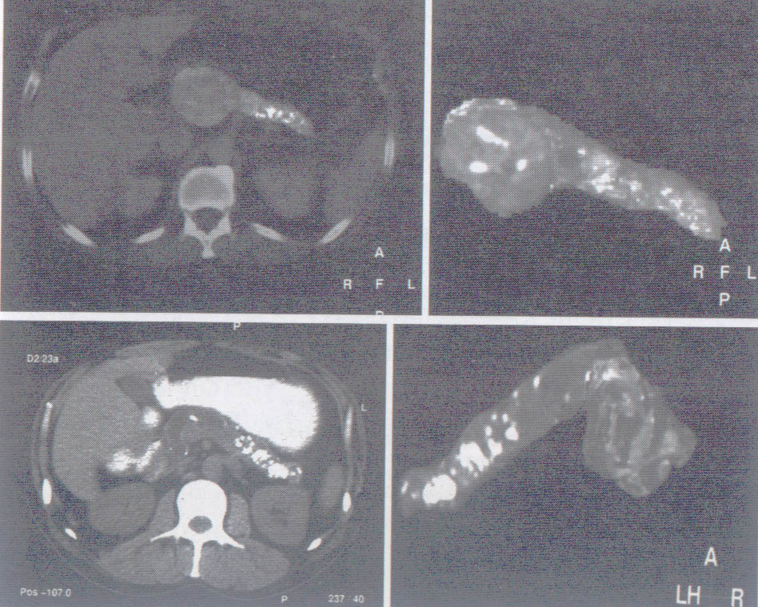
Pancreatic duct calculi (MRI)

Slide 39
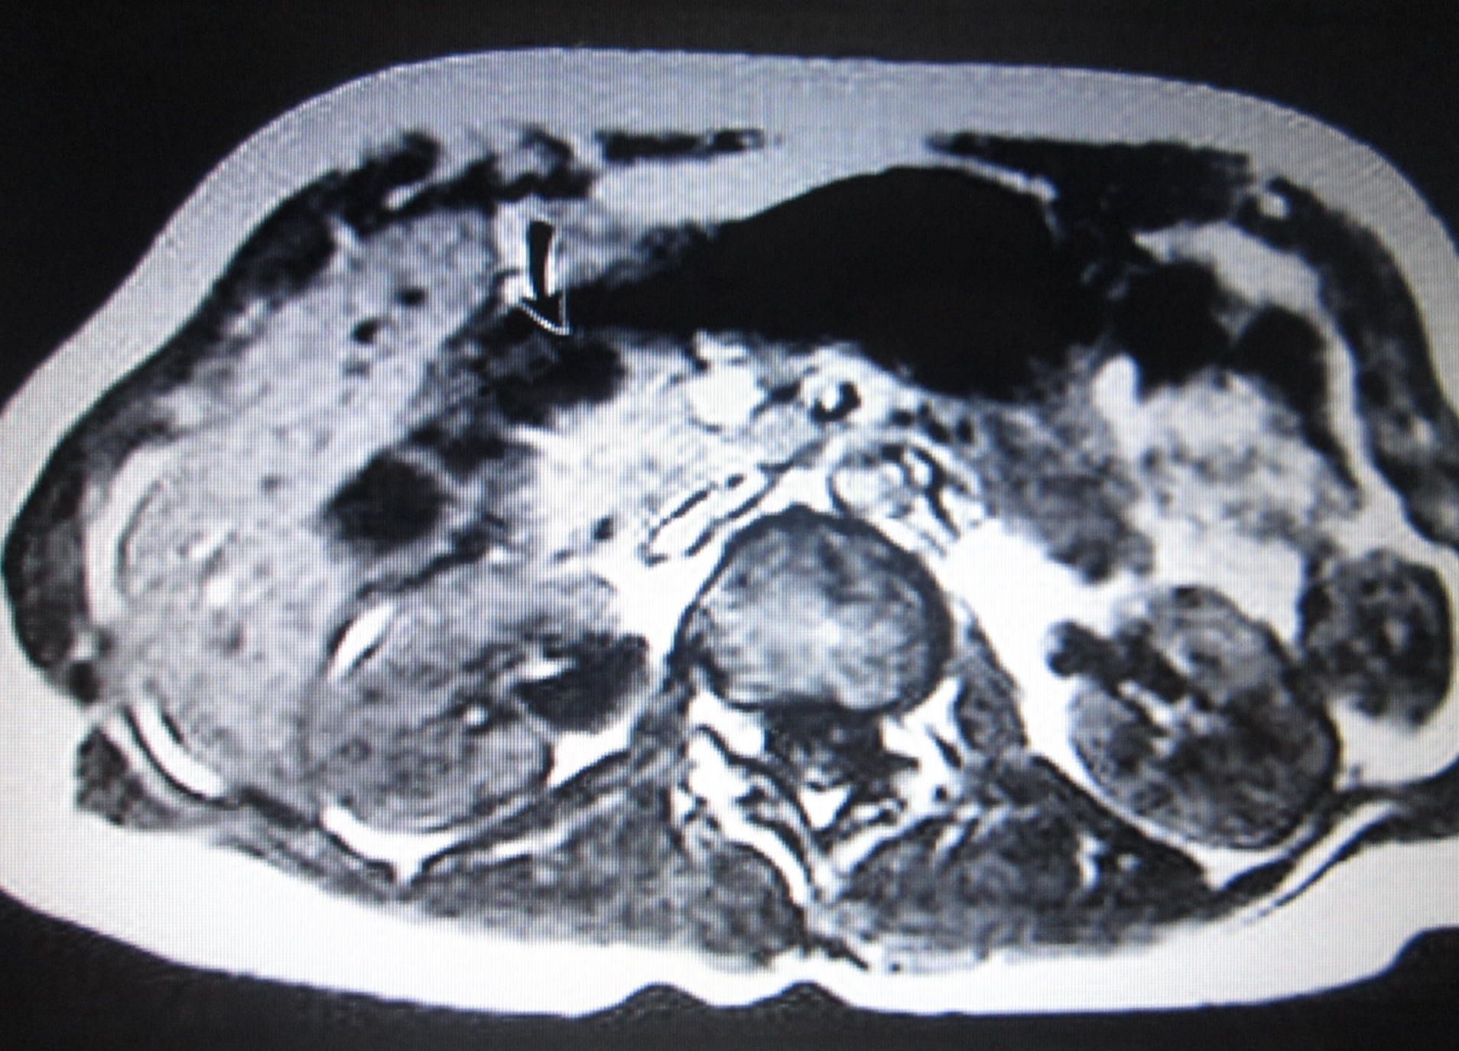
Nuclear magnetic tomography: pancreatic cyst

Slide 40
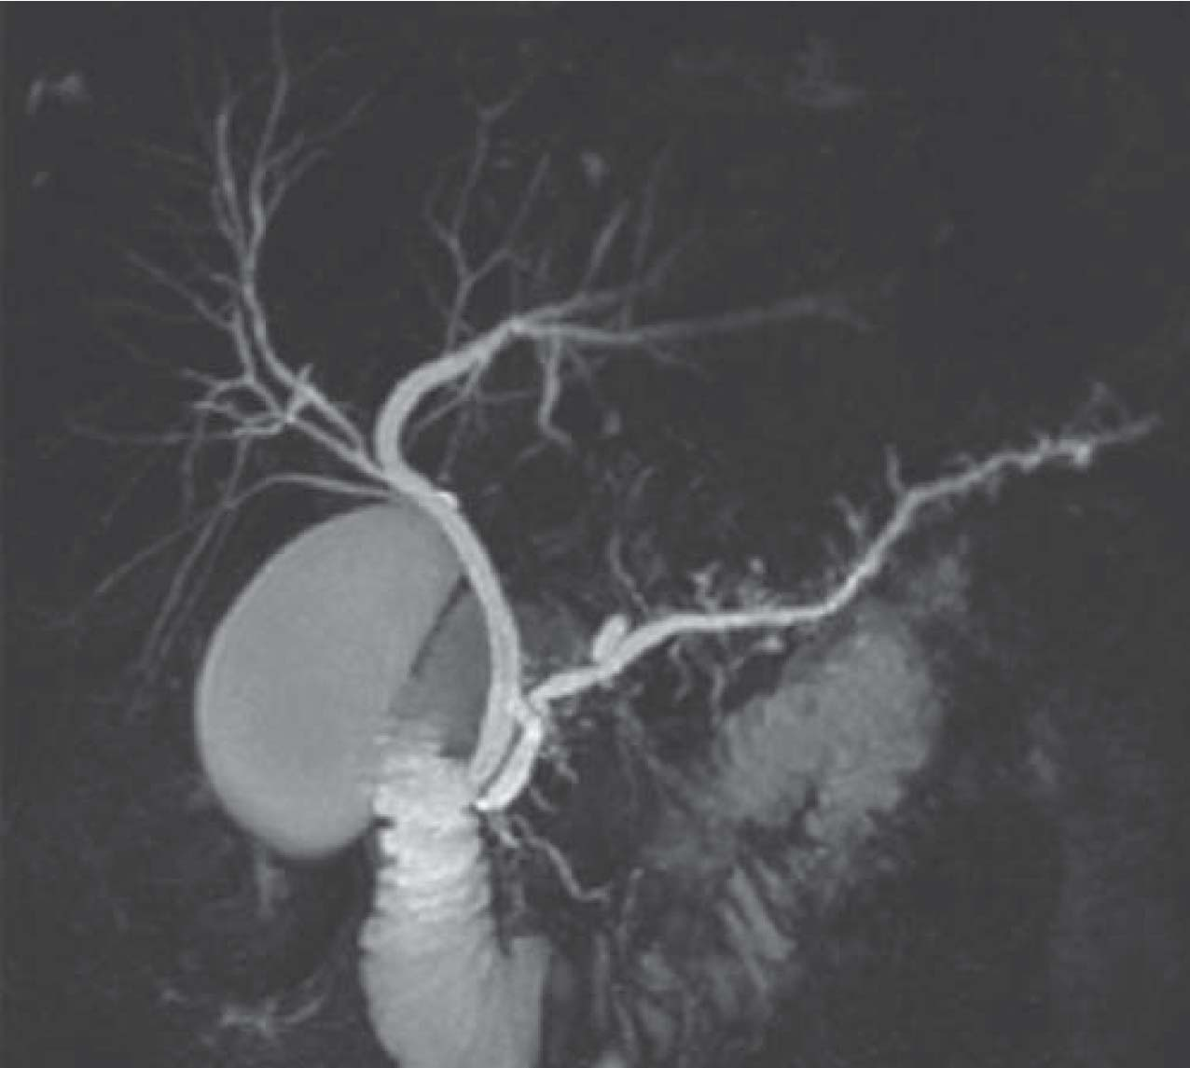
Coronal T2-weighted magnetic resonance image showing evidence of chronic pancreatitis, including a pancreatic duct dilatation and side-branch clubbing.

Slide 41
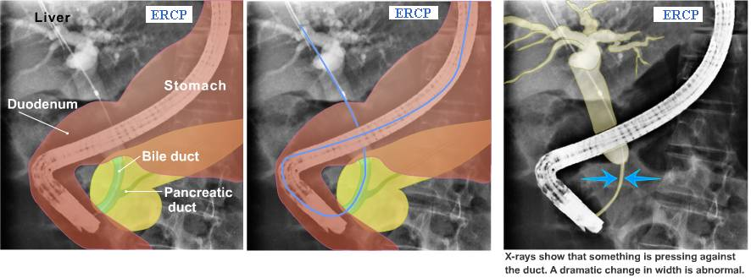

Slide 42
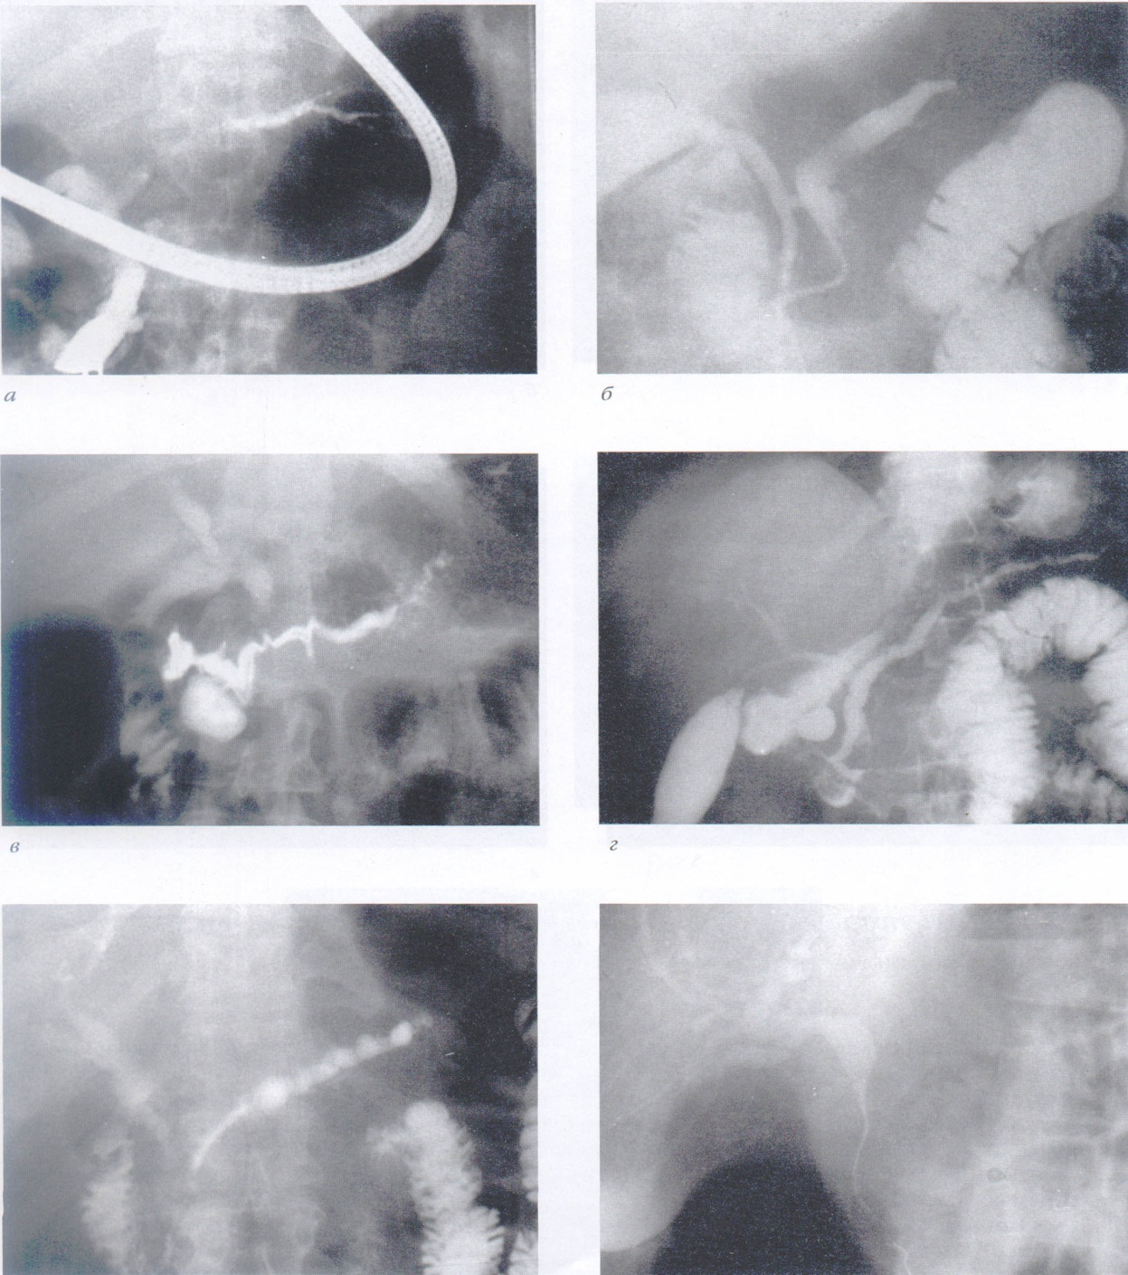

Slide 43
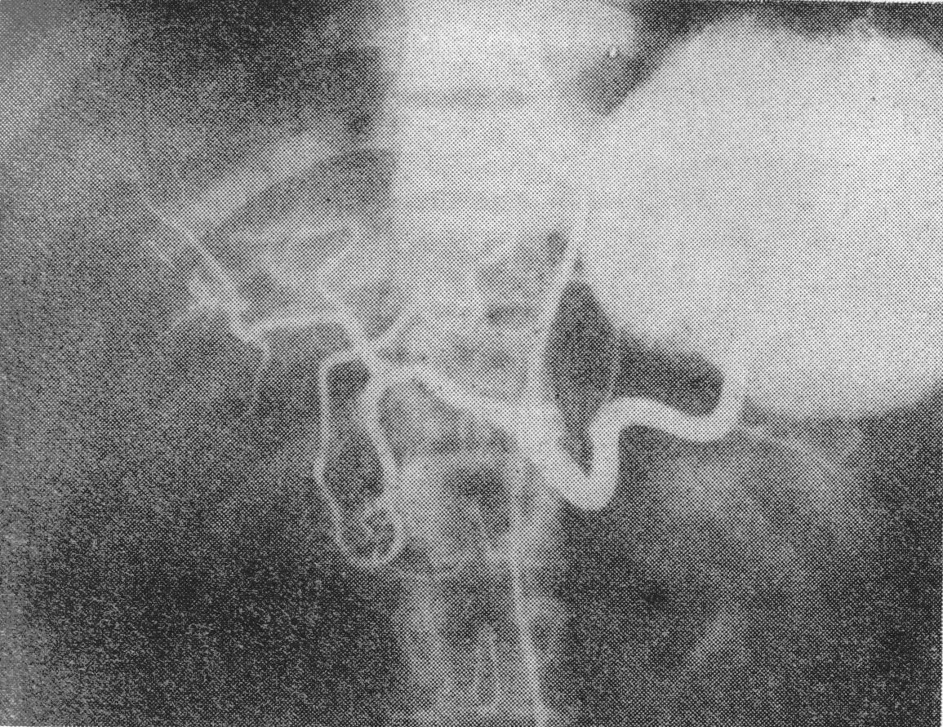
CELIACOGRAM

Slide 44
CONSERVATIVE TREATMENT
Diet (exclude spicy, fatty, fried, alcohol)
Correction of exocrine deficiency (pancreatic enzymes, the drug of choice is Creon)
Correction of endocrine deficiency
The selective use of antisecretory therapy.
Parenteral nutrition with severe malabsorption
Anabolic therapy
Vitamin therapy

Slide 45
Antisecretory Therapy
Enzyme Therapy
Pancreatic enzyme administration serves to reverse the effects of pancreatic exocrine insufficiency.
Adequate pancreatic enzyme replacement reverses the exocrine insufficiency seen in most patients, and it prevents secondary complications such as metabolic bone disease due to inadequate absorption of the fat-soluble vitamins A, D, E, and K. In addition, pancreatic enzyme replacement may reduce or alleviate the pain experienced by patients.
Somatostatin administration has been shown to inhibitpancreatic exocrine secretion. The somatostatin analogue octreotide acetate has therefore been investigated for pain relief in patients with chronic pancreatitis.

Slide 46
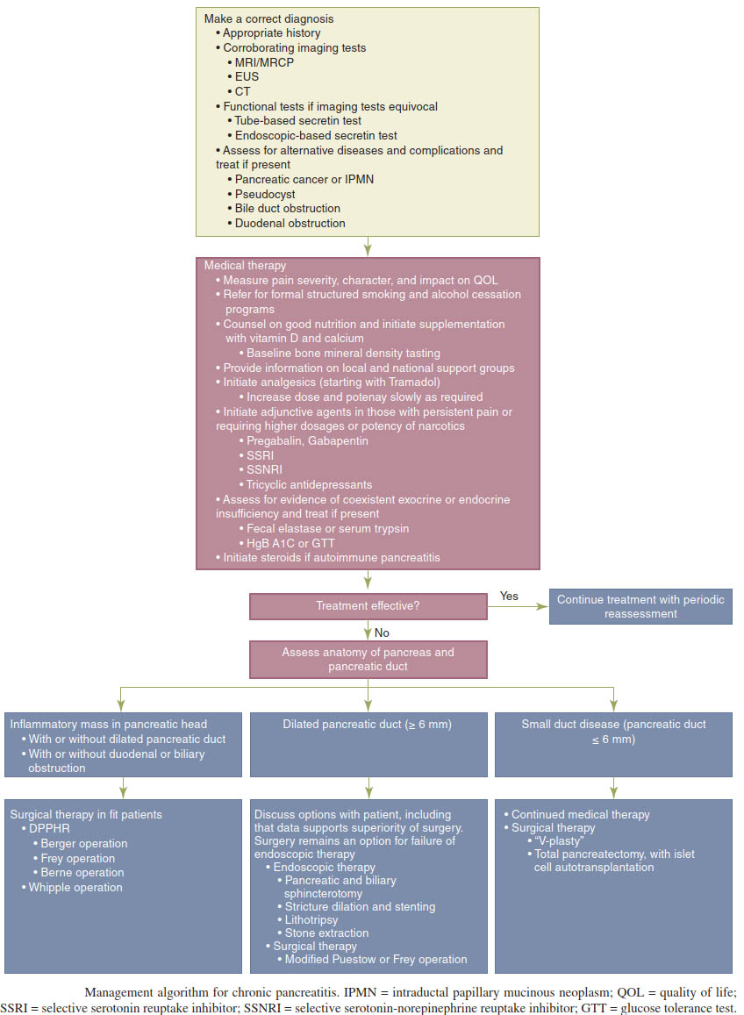

Slide 47
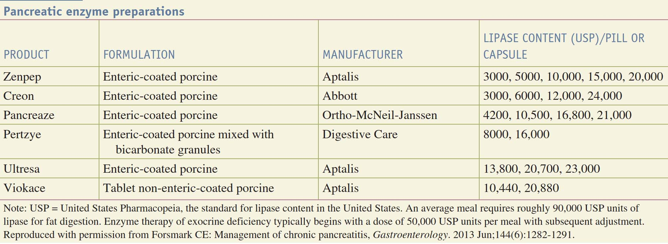

Slide 48
INDICATIONS FOR SURGICAL INTERVENTION:
pain form resistant to conservative treatment;
impaired patency of the ducts of the gland (strictures, calculosis);
chronic pancreatitis with the involvement of neighboring organs (duodenal obstruction, portal hypertension);
formed pseudocyst of the pancreas;
persistent pancreatic fistula;
chronic pancreatitis complicated by obstructive jaundice;
chronic pancreatitis with suspected pancreatic cancer.

Slide 49
I. Direct interventions on the pancreas
1. Resection: distal resection, subtotal resection, pancreatoduodenal resection, pancreatectomy, removal of pancreatic cysts.
2. Internal drainage of the ducts (pancreatojejunoanastomosis according to Puestow-I, Puestow-II, Duwal).
3. Internal drainage of cysts (cystogastroanastomosis, cystoduodenoanastomosis, cystoeunoanastomosis).
4. Occlusion of the duct system.
5. External drainage of ducts and cysts.
II. Operations on organs adjacent to the pancreas:
1. operations on the biliary tract and the large duodenal papilla;
2. surgery on the stomach and duodenum.
III. Operations on the autonomic nervous system

Slide 50
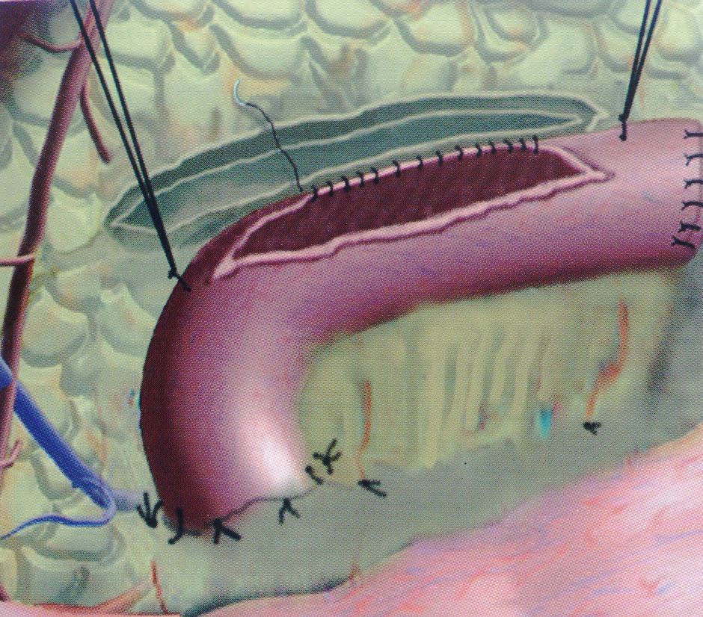
PANCREATOJEJUNOANASTOMOSIS

Slide 51
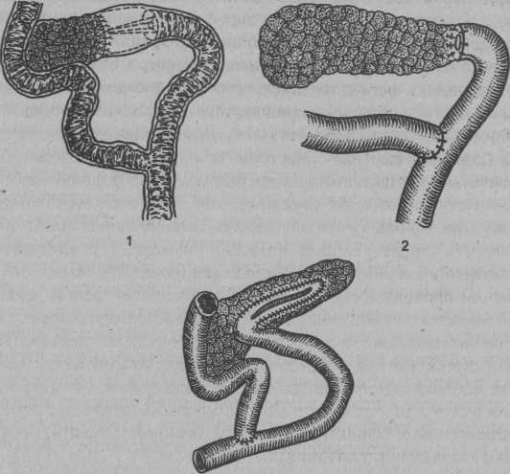
1 – Puestow I; 2 – Duwal; 3 –Puestow II

Slide 52
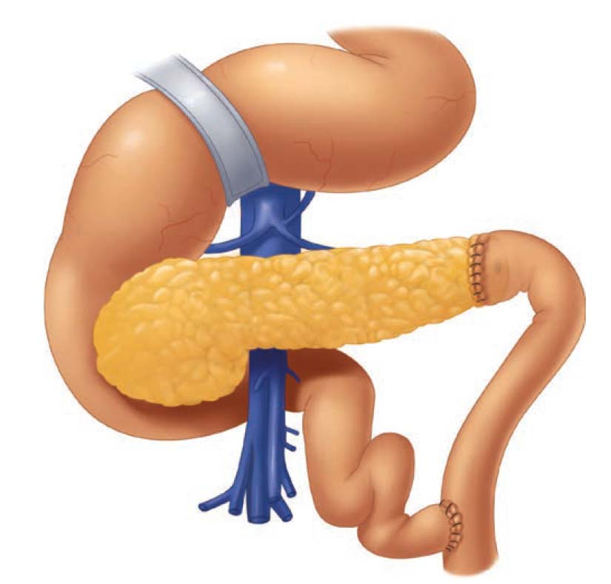
Duval’s caudal pancreaticojejunostomy.

Slide 53
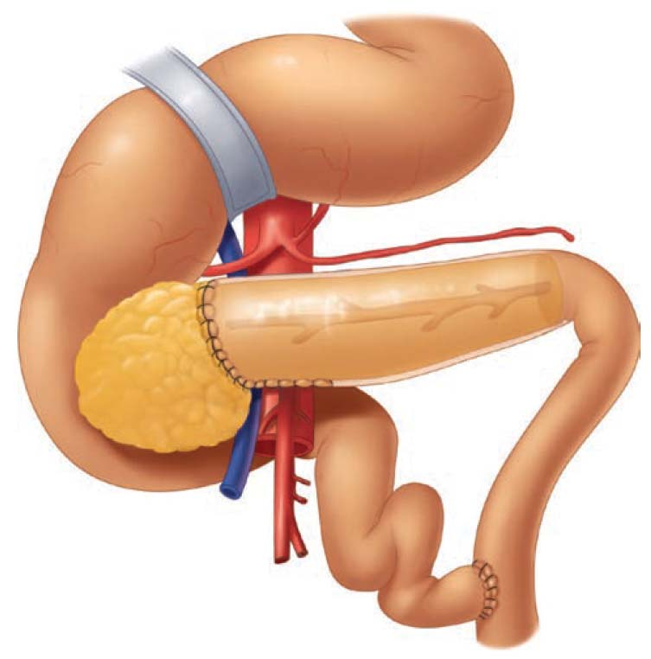
Puestow and Gillesby’s longitudinal pancreaticojejunostomy. Originally described as an invaginating anastomosis that drained the entire body and tail, the anastomosis was created after amputating the tail of the gland and opening the duct along the long axis of the gland.

Slide 54
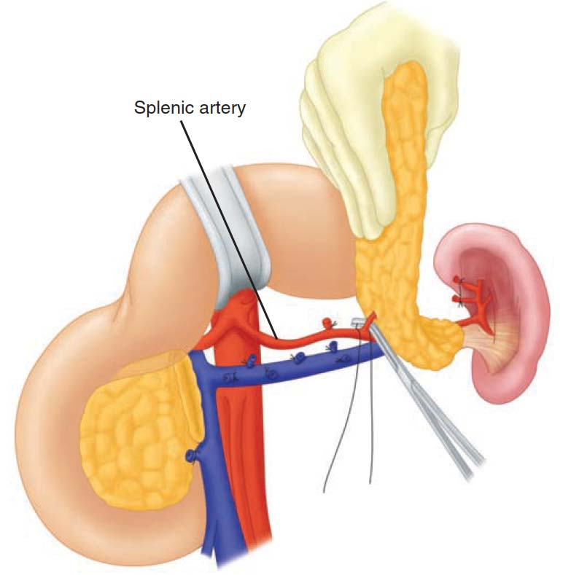
Distal (spleen-sparing) pancreatectomy. A distal pancreatectomy for chronic pancreatitis is usually performed with en bloc splenectomy, using either an open or laparoscopic technique. In the presence of minimal inflammation, a spleen-sparing version can be performed, as shown here.

Slide 55
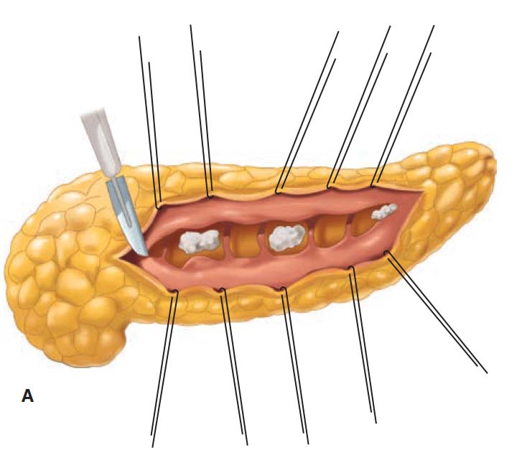
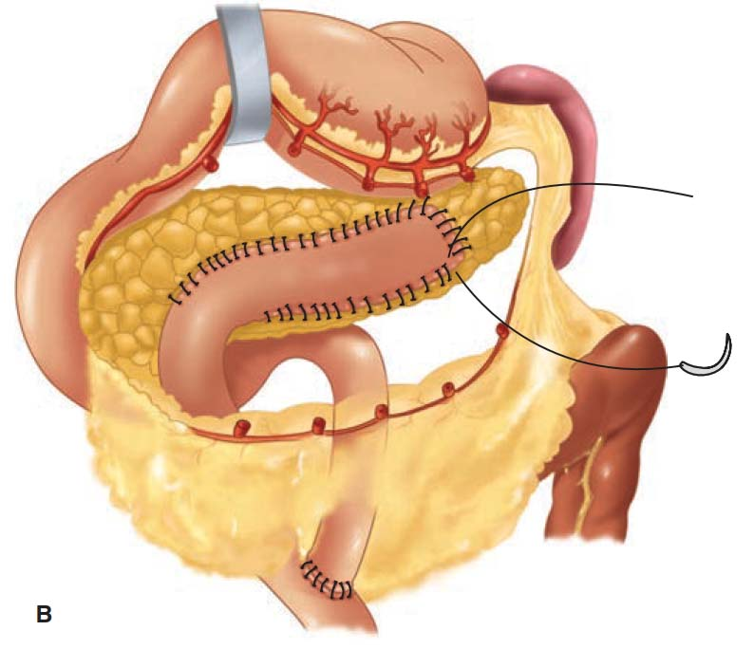
Longitudinal dochotomy in obstructing calcific pancreatitis. A longitudinal pancreatotomy typically discloses segmental stenosis of the pancreatic duct and the presence of intraductal calculi in a patient with chronic calcific pancreatitis (A). Following mobilization of a Roux limb of jejunum, a longitudinal pancreaticojejunostomy is performed to permit extensive drainage of the pancreatic duct system (B). This technique, described by Partington and Rochelle, is the typical method used for the Puestow procedure.

Slide 56
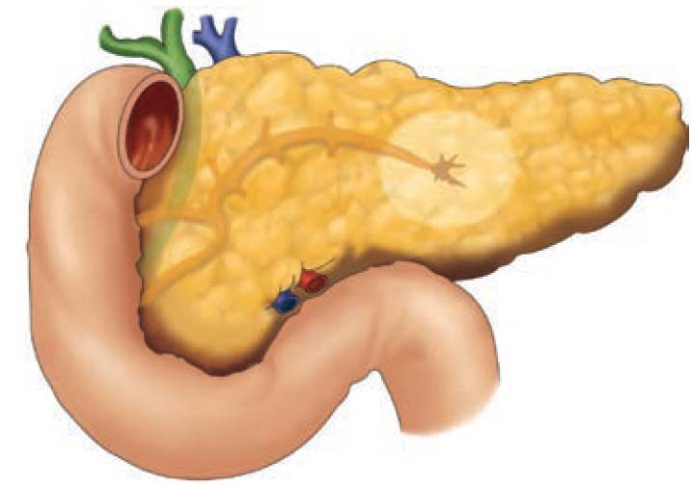
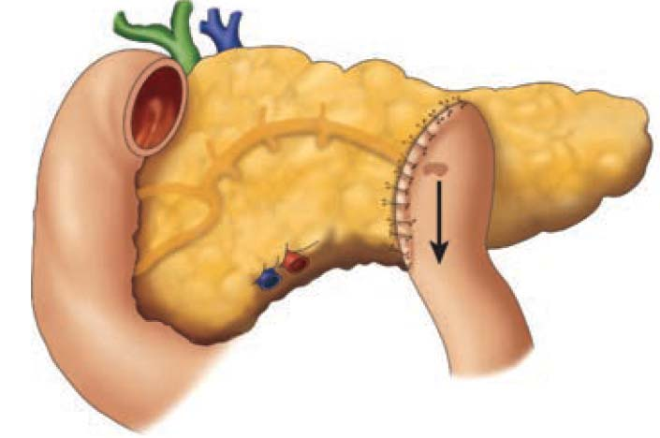
Internal drainage for leaking pancreatic duct. A Roux-en-Y pancreaticojejunostomy is performed at the site of duct rupture to accomplish internal drainage of the pancreatic duct leak.

Slide 57
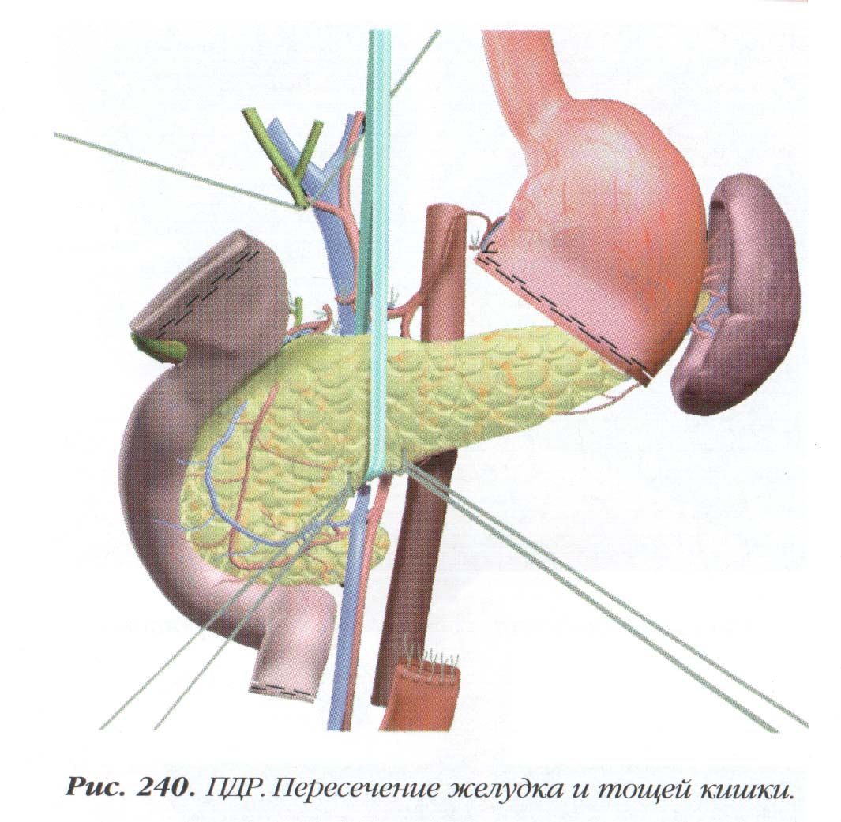
PANCREATODUODENAL RESECTION

Slide 58
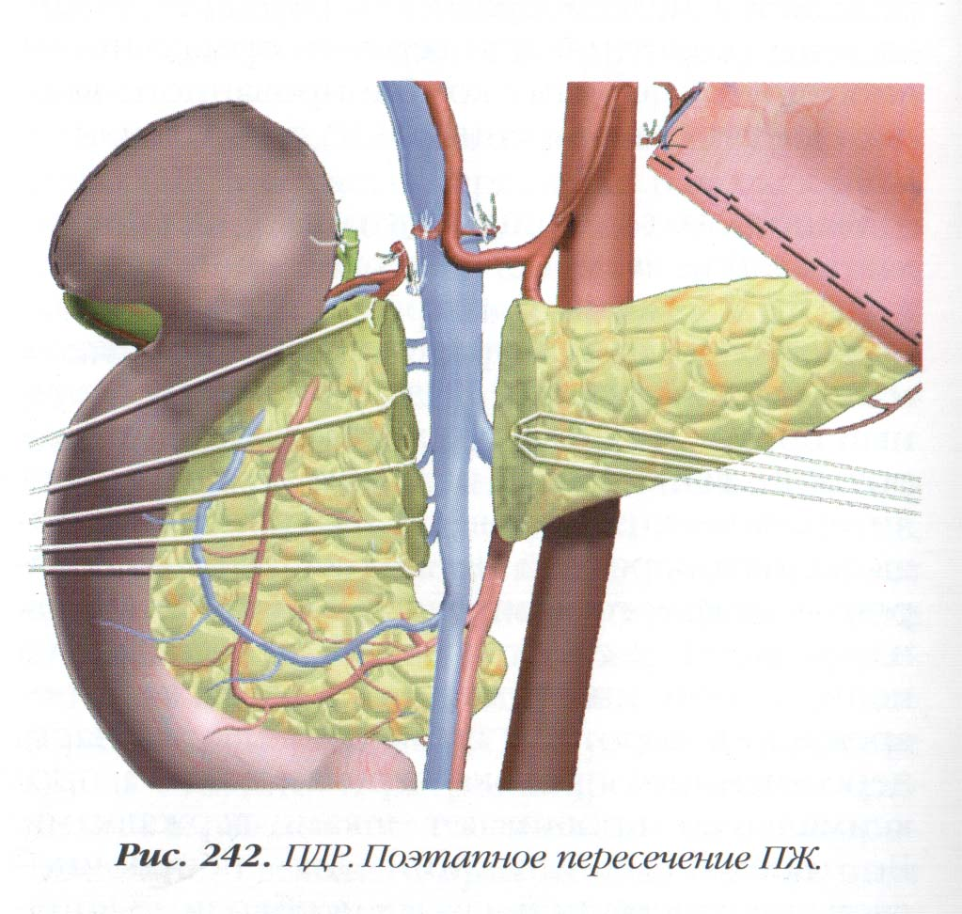
PANCREATODUODENAL RESECTION

Slide 59
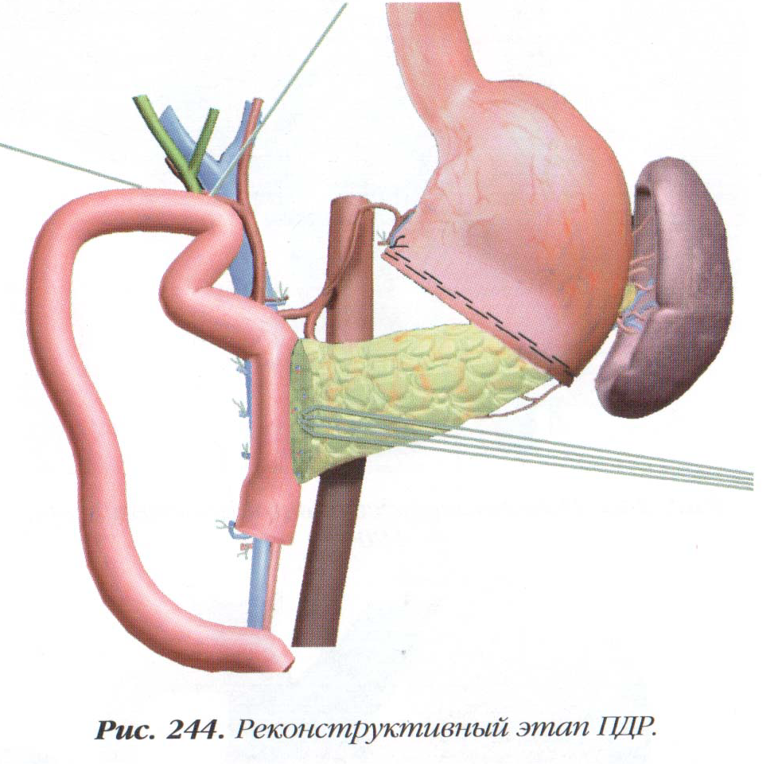
PANCREATODUODENAL RESECTION

Slide 60
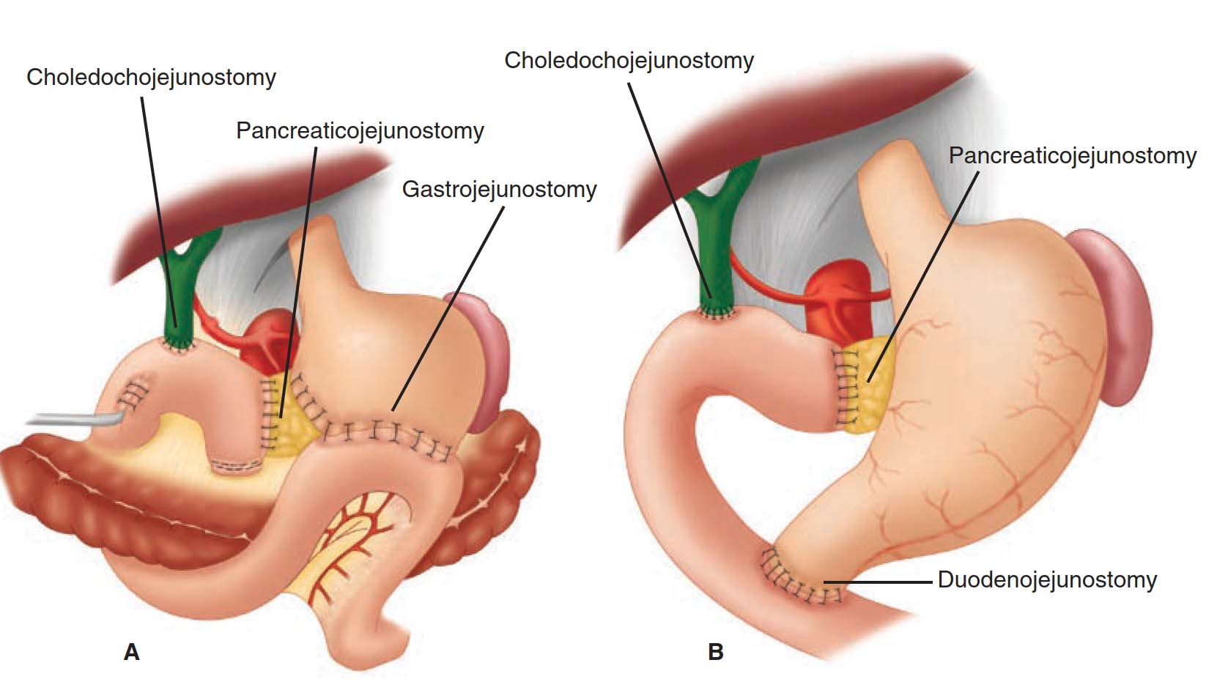
The pancreaticoduodenectomy (Whipple procedure) can be performed either with the standard technique, which includes distal gastrectomy (A), or with preservation of the pylorus (B). The pylorus-sparing version of the procedure is used most commonly.

Slide 61
TYPES OF ORGAN-PRESERVING OPERATIONS
1) Subtotal duodenum-preserving resection of the pancreatic head - Beger operation;
2) Subtotal duodenum-preserving local resection of the pancreatic head - Bernese modification of Beger operation;
3) Local (partial) resection of the pancreatic head with longitudinal pancreaticenteroanastomosis - Frey's operation;

Slide 62
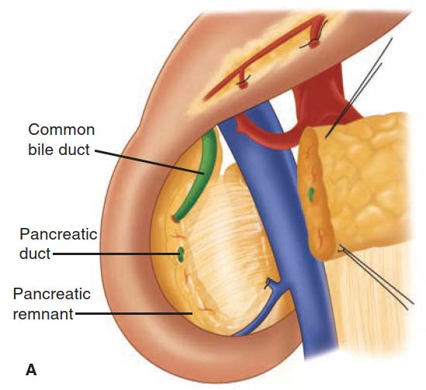
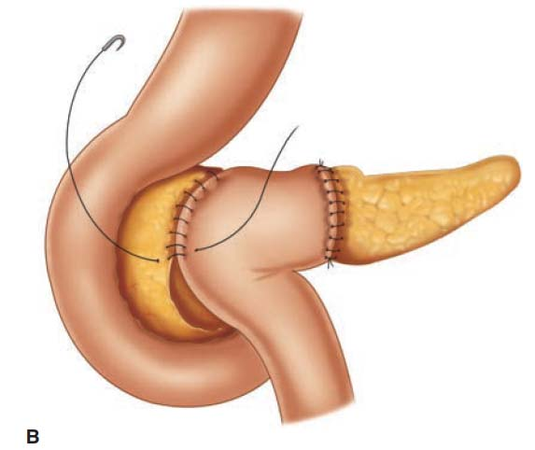
The duodenum-preserving pancreatic head resection described by Beger and colleagues. A. The completed resection after transection of the pancreatic neck, and subtotal removal of the pancreatic head, with preservation of the distal common bile duct and duodenum. B. Completion of the reconstruction with anastomosis to the distal pancreas and to the proximal pancreatic rim by the same Roux limb of jejunum.

Slide 63
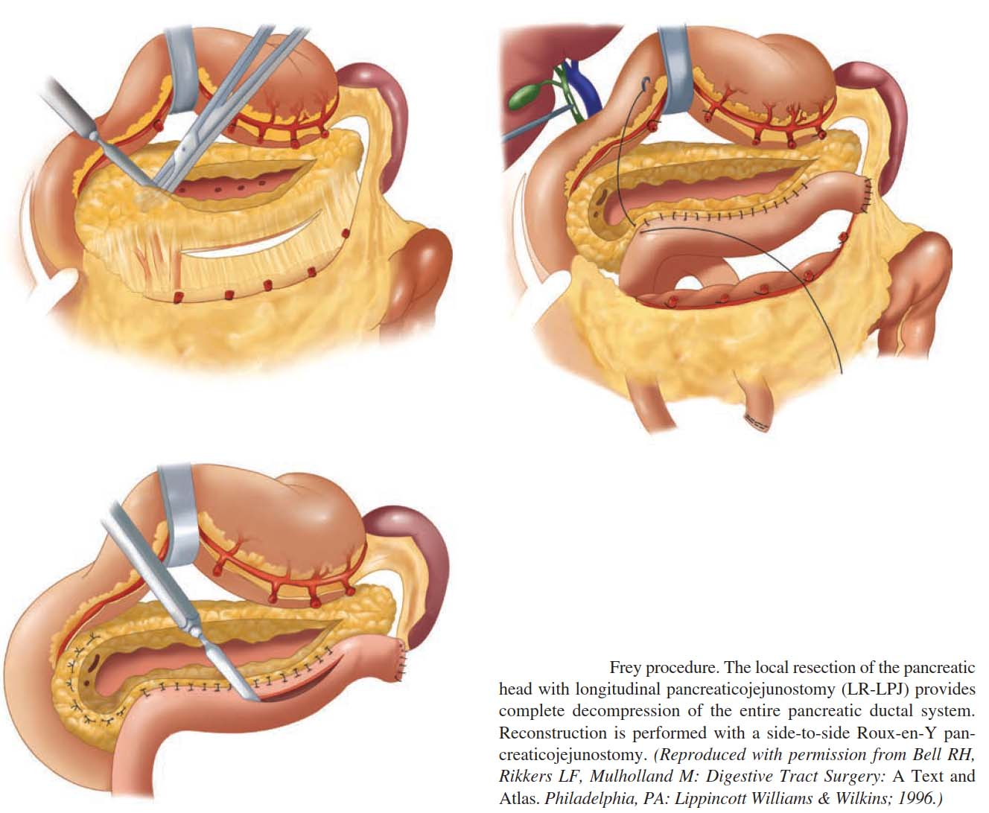

Slide 64
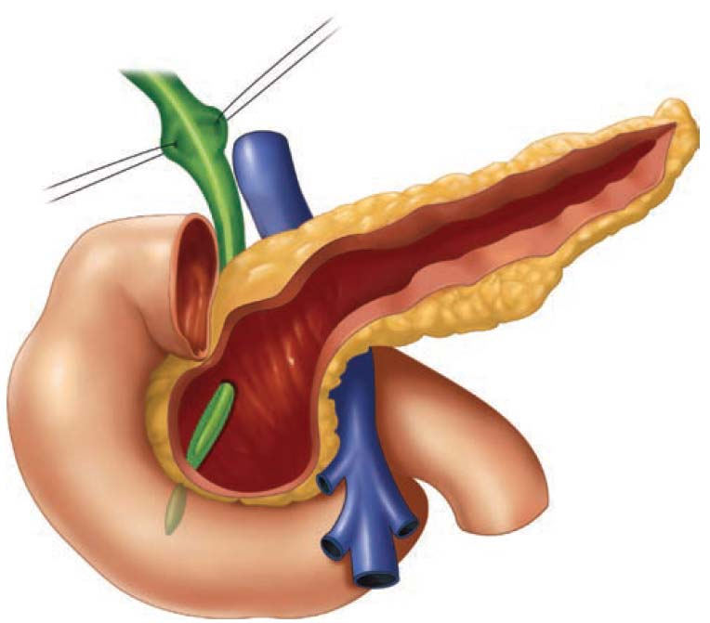
The Hamburg modification of the local resection of the pancreatic head with longitudinal pancreaticojejunostomy.

Slide 65
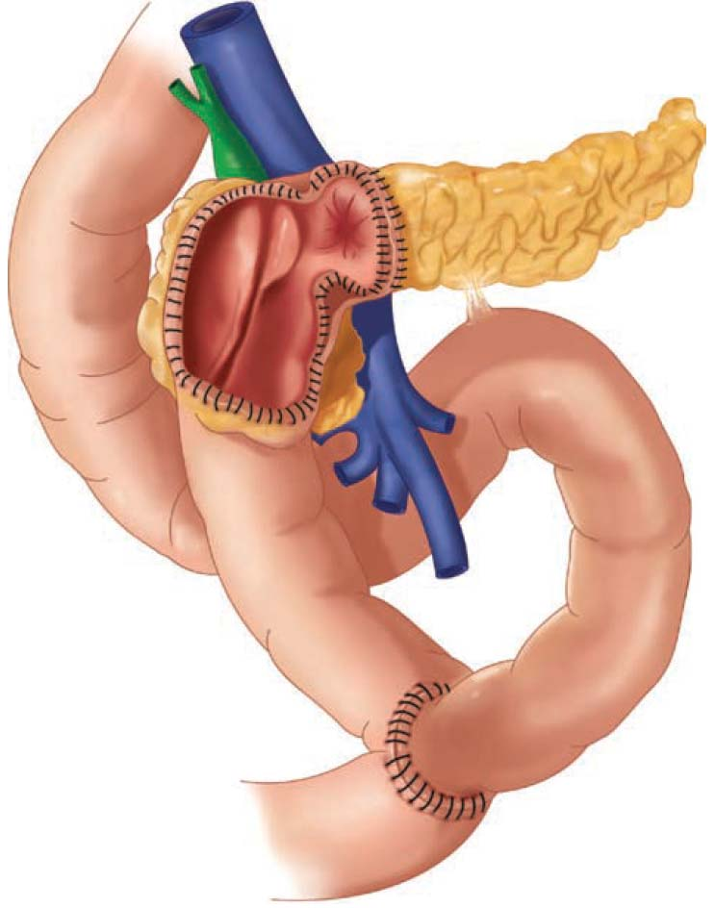
The Berne modification of the local resection of the
pancreatic head with longitudinal pancreaticojejunostomy.

Slide 66
CLASSIFICATION OF PANCREATIC CYSTS
Etiology:
1. Congenital:
a) dermoid cysts,
b) polycystic degeneration,
c) cystic-fibrous degeneration (Landsteiner-Fanconi-Andersen syndrome) - intestinal-broncho-pancreatic dystopia
2. Acquired:
a) retention cysts (violation of the outflow)
b) degenerative cysts (post-necrotic).
c) parasitic cysts (echinococcosis, cysticercosis).
d) proliferative cysts (cystadenoma, cystadenocarcinoma).
II. MORPHOLOGY:
1. True (congenital, retention, proliferative)
2. False (degenerative, parasitic)

Slide 67
III. Formation stages (R.G. Karagulian, 1972):
1. up to 1.5 months - unformed, represented by a decay cavity, sequestration
2. up to 3 months - the wall is made of granulations
3. up to 1 year - fibrous tissue
4. over a year - capsule formed
IV. Complications:
1. Uncomplicated
2. Complicated
a) suppuration
b) perforation (in the abdominal, pleural cavity, pericardium)
c) bleeding (into the cavity of the cyst, abdominal cavity)
d) compression of the surrounding organs (common bile duct, portal vein, stomach, left kidney, colon)
e) fistula formation
e) malignancy
V. By the nature of the clinical course: 3 periods: (asymptomatic, symptomatic, complications)
1. Primary 2. Recurrent.

Slide 68
By localization
Head
Body
Tail

Slide 69
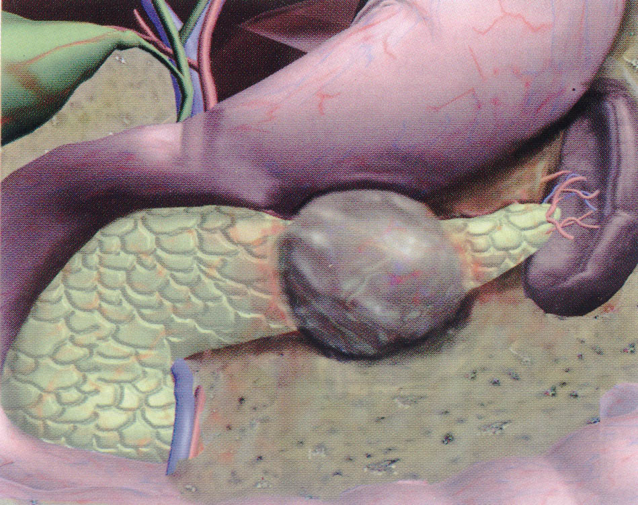

Slide 70
CLINICAL MANIFESTATIONS
Pain in the upper abdomen (cyst pressure)
Dyspepsia (exocrine insufficiency)
Losing weight
Palpation-determined volumetric formation
Temperature (suppuration)

Slide 71
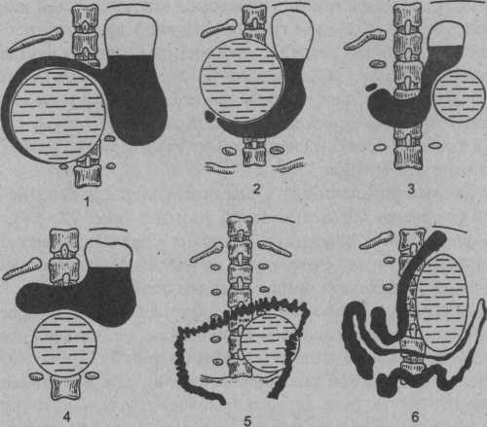

Slide 72
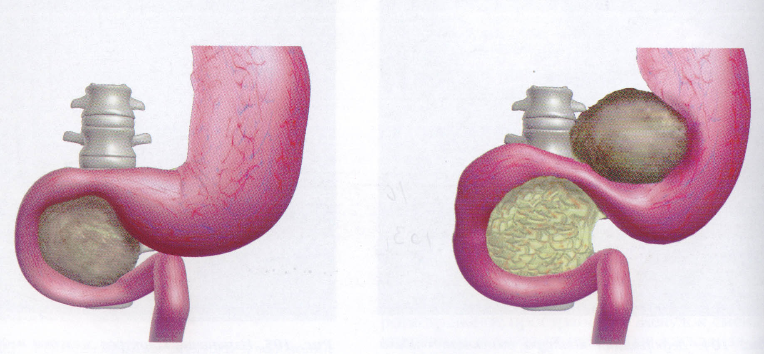

Slide 73
Diagnosis (as in chronic pancreatitis)
X-ray of the stomach, 12-p.
Ultrasound
CT, MRI
ERCP,
celiacography

Slide 74
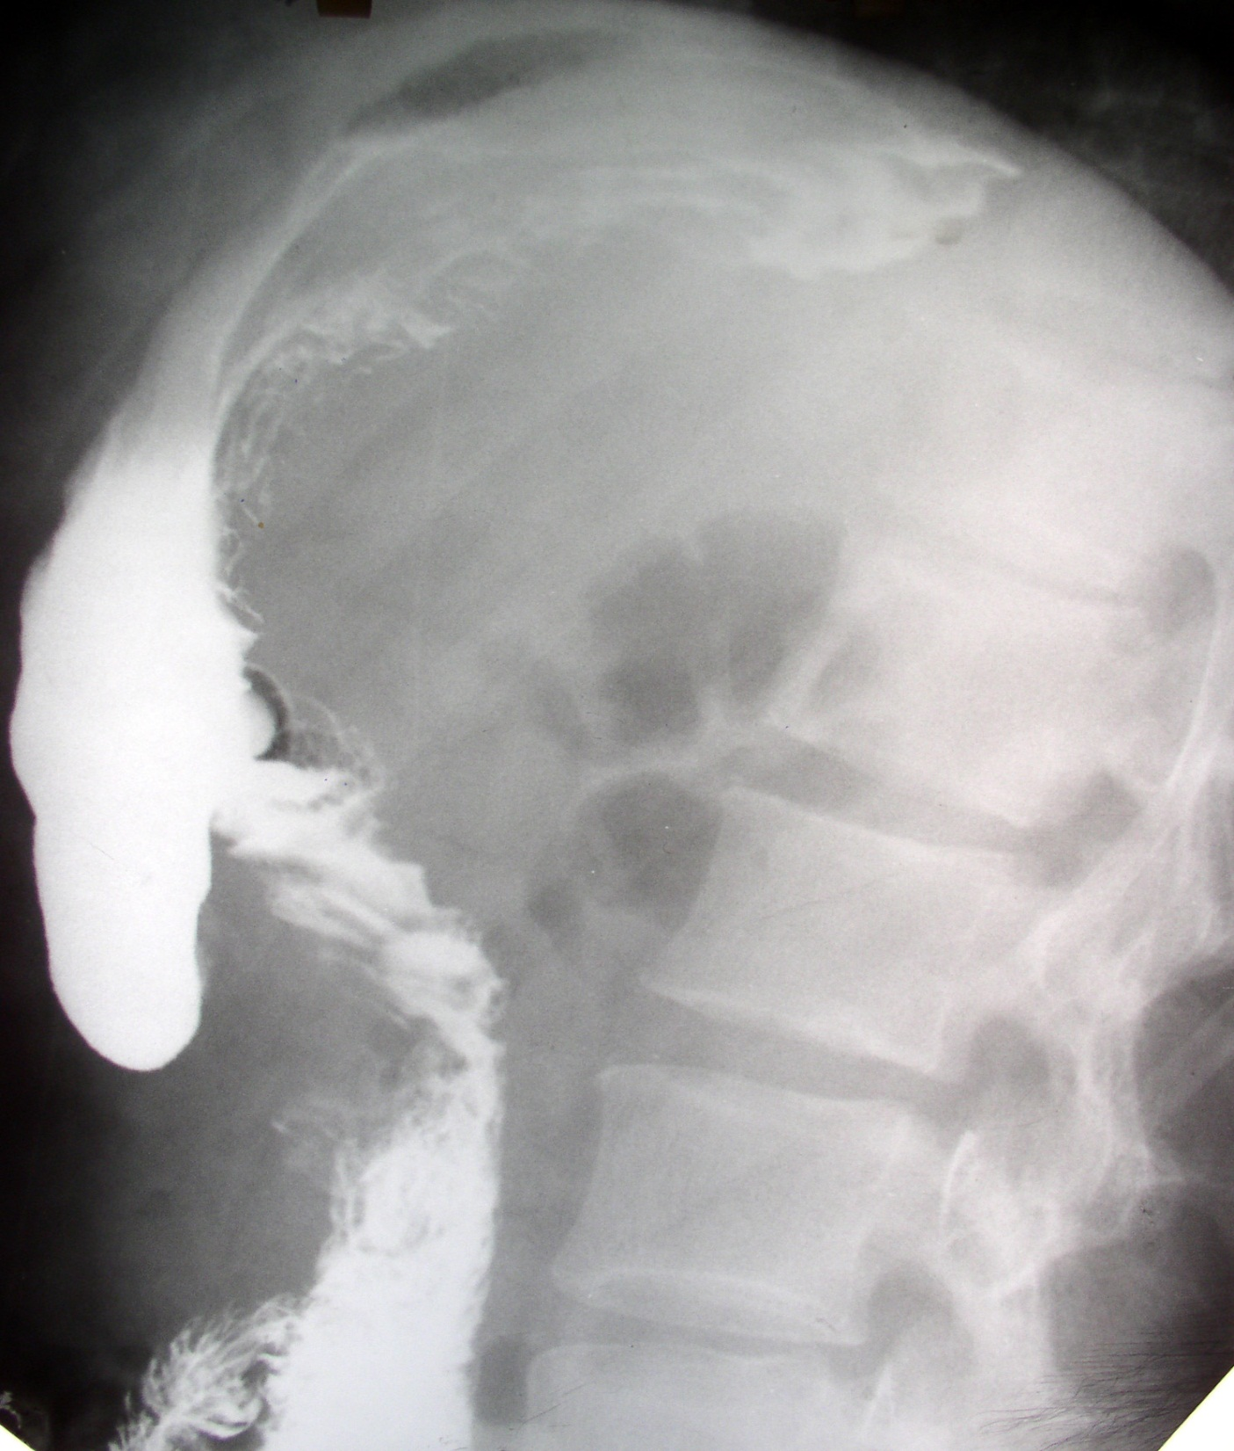

Slide 75
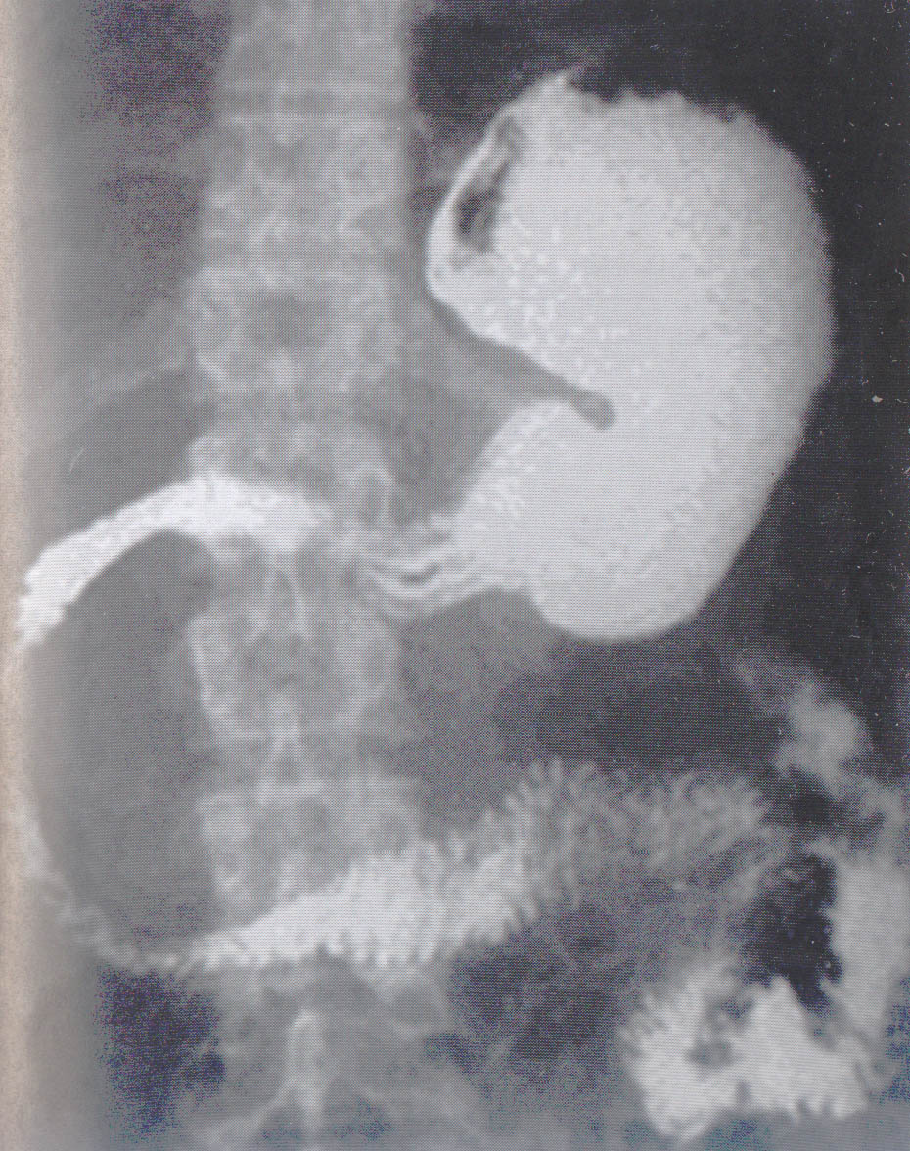
Deployment of the contour of the duodenum

Slide 76

Ultrasound. Pancreatitis, pseudocyst

Slide 77


Slide 78

Computed tomography: pancreatic cyst

Slide 79
Small cysts -
conservative treatment: sandostatin, octreotide
anti-inflammatory, absorbable drugs, antibiotics, probiotics, physical therapy, radiotherapy.
Large cysts are an operation.

Slide 80
THE MAIN TYPES OF SURGICAL TREATMENT OF PANCREATIC CYSTS
External drainage (puncture, operative)
Internal drainage (cystogastro, cystejunoanastomoses)
Incomplete cyst removal
Complete cyst removal

Slide 81


Slide 82


Slide 83


Slide 84

THE PUNCTURE METHOD

Slide 85


Slide 86


Slide 87


Slide 88


Slide 89


Slide 90


Slide 91

Cystogastrostomy drainage of a retrogastric pancreatic pseudocyst. A larger opening is made through the common wall of a retrogastric pseudocyst, and a portion of the pseudocyst wall is submitted for histologic confirmation of the diagnosis. Suture reinforcement of the communication is performed to avoid the complication of bleeding.

Slide 92


Technique of endoluminal cystogastrostomy. A. Endoscopic ultrasound (EUS)-guided transgastric puncture of pancreatic pseudocyst. B. Transgastric stents placed across fused posterior wall of stomach and anterior wall of pseudocyst.

Slide 93


Transpapillary drainage of a pancreatic pseudocyst.
A. Endoscopic passage of a flexible wire through the major papilla, through the pancreatic duct, and into a communicating pseudocyst. B. Placement of a stent over the wire into the pseudocyst with transpapillary drainage.

Slide 94


Slide 95


Slide 96


PANCREATIC CYSTS

Slide 97


Slide 98

Distal resection

Slide 99

Pancreatic fistula

Slide 100
CLASSIFICATION OF FISTULAS.
I. By etiology:
1 Postnecrotic fistula.
2. Post-traumatic fistulas (including surgical trauma).
3. Fistulas after external drainage of cysts.
II. According to the clinical course:
1. Permanent. 2. Recurrent.
III. In connection with the duct system of the pancreas:
1. Fistula associated with GLP (Wirsungs):
a) Wirsung duct well pass
b) Wirsung duct poorly pass
2. Non-ductal fistulas

Slide 101
IV. According to the fistulous course:
1. Outdoor fistulas
2. Internal fistulas
3. Mixed fistulas.
V. Localization: head, body, tail
VI. By the amount of discharge:
1. Complete
2. Incomplete

Slide 102
Three periods of the clinical course
Fistula formation period
The period of functioning of the fistula
Complication period

Slide 103
Fistula formation period
1. pain in the epigastrium and in the left hypochondrium
2. dyspeptic disorders
3. fever
4. leukocytosis
5. the appearance of infiltrate in the projection of the pancreas

Slide 104
The period of functioning of the fistula
1. The presence of holes with the release of pancreatic secretion.
2. Maceration and skin irritation around the fistula.

Slide 105
COMPLICATION PERIOD
1. Digestion disorder with a disorder of all types of metabolism, acid-base condition (hypoproteinemia, hyponatremia, etc.)
2. Dehydration.
3. Dystrophy of the parenchymal organs
4. Progressive exhaustion

Slide 106
TREATMENT
I. Conservative + occlusion (filling)
1. fistula is not connected to the duct
2. fistula associated with the duct and its good patency
II. Prompt
1. The ineffectiveness of drug therapy for 3 months;
2. violation of the outflow of pancreatic secretion into the duodenum;
3. the presence of fistulous passage, communicating with poorly draining cavities in parapancreatic tissue;
4. progression of inflammatory and destructive processes in the pancreas.

Slide 107
Conservative treatment:
inhibition of exocrine pancreatic function (sandostatin, radiotherapy)
inactivation of pancreatic juice enzymes;
sanitation of the fistulous course with antiseptics and sclerosants
Skin protection around the fistulous course;
correction of disorders of protein, carbohydrate, fat, VEO, lipid and other exchanges;
treatment of concomitant diseases.

Slide 108
SURGERY
1. Excision of the fistula with resection of the pancreas,
2. Excision of the fistula with resection of the pancreas and the formation of pancreatojejunoanastomosis.
3. The formation of anastomosis of the fistula with the stomach or intestines (pancreatophilulodigestive anastomosis).
4. Excision of the fistulous passage with its ligation at the base.
5. Fillings of the fistulous course and pancreatic duct

Slide 109
Пломбировка:
Эменил М-3
Рабром
КМ-3
Неопрен
Полиизопрен
Проламин
Цианкрилат
Тиссокол

Slide 110


Slide 111
Спасибо за внимание

Slide 112

Эхографическая картина нормальной поджелудочной железы. 1 - печень; 2 - головка поджелудочной железы; 3 - тело поджелудочной железы; 4 - Вирсунгов проток; 5 - хвост поджелудочной железы; 6 -верхняя брыжеечная артерия; 7 - нижняя полая вена; 8 - аорта; 9 - селезеночная вена; 10 - желчный пузырь; 11 - позвоночник

Slide 113

Контур железы при ХП может быть неровным за счет за счет втяжений и выпуклостей, обусловленных альтеративно-воспалительным процессом. Следует учитывать давность заболевания, т.к. в начальных стадиях развития ХП контуры ПЖ четкие, ровные и железа имеет обычную форму.

Slide 114

Хронический воспалительный процесс в ПЖ и парапанкреатической клетчатке может приводить к сдавлению, тромбозу воротной вены или её притоков. . С высокой степенью достоверности при УЗИ можно выявить тромбоз участка спленопортального русла (Рис. 8, а), а также степень сдавления его измененной ПЖ.
Рис. 8. Эхограмма ХП с тромбозом спленопортального русла: а) тромб (частично реканализированный) в просвете воротной вены; б) левый печеночный проток; в) правый печеночный проток; г) правая ветвь воротной вены;

Slide 115

Кальцификация ПЖ

Slide 116

Кальцификация ПЖ

